Slide 1
The Simple Biostat Program
Stanley B. Pounds
Associate Dean, MS of Applied Biomedical Data Seciences
Member (Professor), Department of Biostatistics
St. Jude Children’s Research Hospital

Slide 2
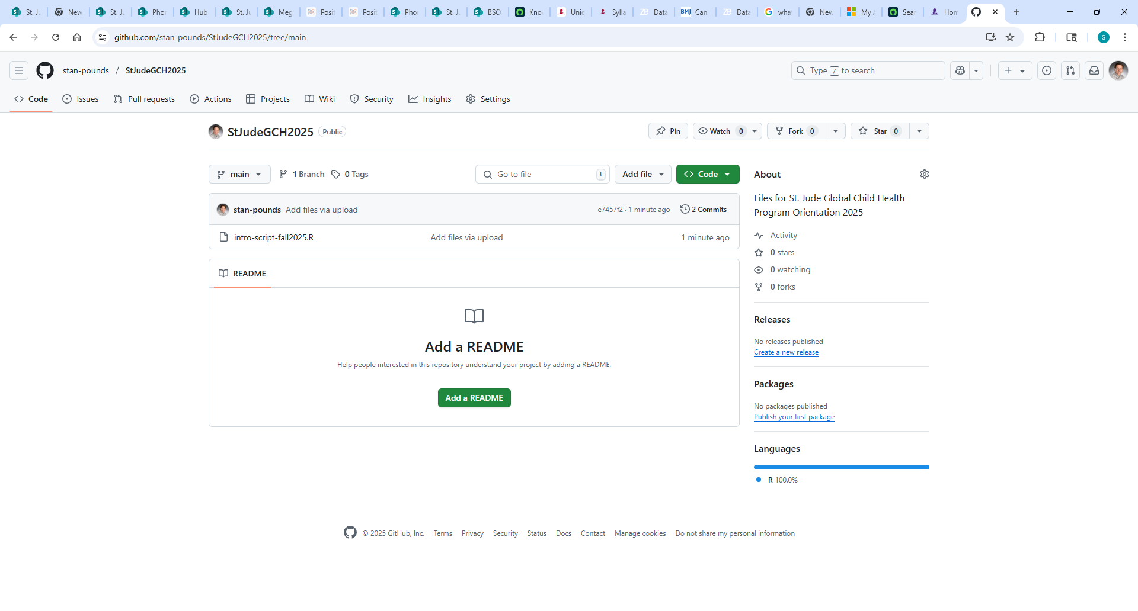
https://github.com/stan-pounds/StJudeGCH2025/

Slide 3
Getting Started in Each New R Session
sbp.link="https://raw.githubusercontent.com/stan-pounds/Simple-Biostats-Program/main/setup-SBP.R")
source(sbp.link)
Read and name data
data.name = read.data()
# Choose file in pop-up window
Preview data
View(data.name)
colnames(data.name)
General Syntax
result = function(info1, info2, …)
# user chooses result name
Color Name Legend
show.colors()
show.palettes(number)
Descriptive Stats & Graphs
describe("column.name", data.name)
Copy Figure to Word
In the Plots tab, Click Export > Copy to Clipboard > Copy Plot.
Estimate One Population Parameter
estimate("column.name", data.name)
Copy Tabular Result to Word
word.table(result.name)
Compare a Variable across Groups
compare(variable.name~group.name, data.name)
Common Options
Narrative: txt = 0 (none), 1 (some), 2 … (more)
Tables: tbl = 0 (none), 1 (some), 2 … (more)
Figures: fig = 0 (none), 1 (some), 2 … (more)
Colors: clr = c("color1.name", "color2.name")
Colors: clr = "palette.name"
Output Labels: y.name, x.name, or grp.name = "name"
Correlate Two Numeric Variables
correlate(y.name~x.name, data.name)
Fit a Predictive Model
model(y.name~x1.name+x2.name, data.name)
Specific Options
estimate: null = number
correlate: line = NA (no line), 0 (flat line), 1 (fitted line)
Prepared by Stan Pounds 06/04/2024

Slide 4
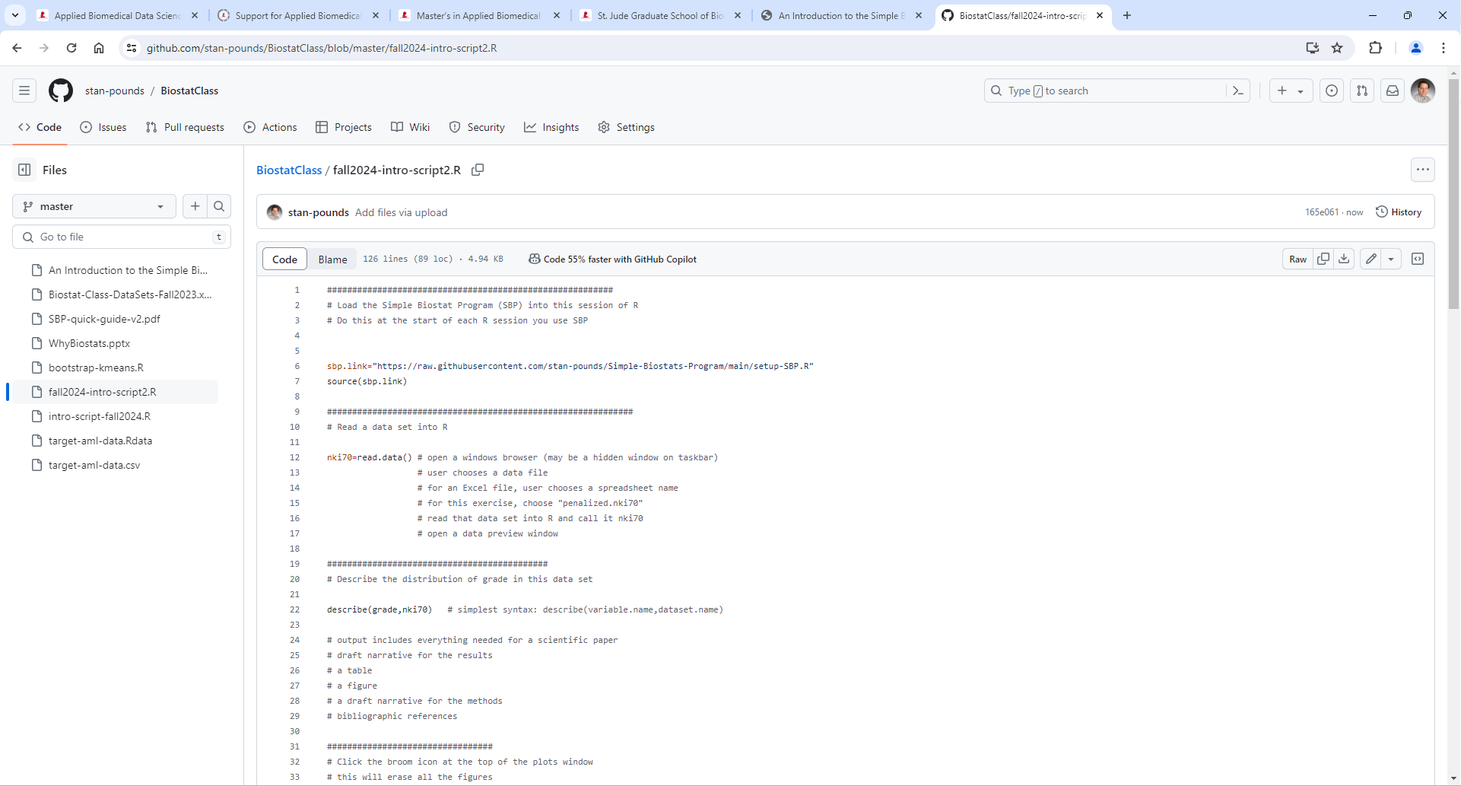
https://github.com/stan-pounds/StJudeGCH2025/blob/main/intro-script-fall2025.R
Click the download icon.

Slide 5
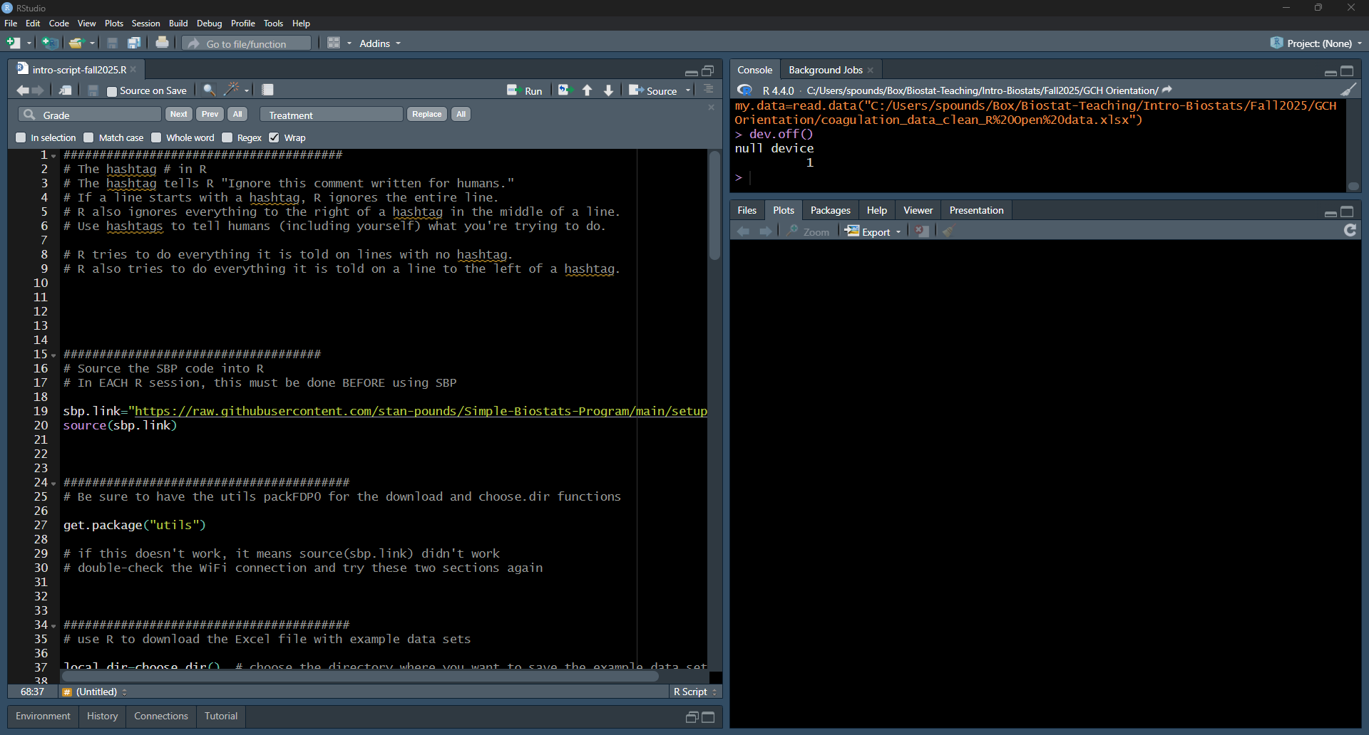
R Studio: intro-script-fall2025.R

Slide 6
Getting Started in Each New R Session
sbp.link="https://raw.githubusercontent.com/stan-pounds/Simple-Biostats-Program/main/setup-SBP.R")
source(sbp.link)
Read and name data
data.name = read.data()
# Choose file in pop-up window
Preview data
View(data.name)
colnames(data.name)
General Syntax
result = function(info1, info2, …)
# user chooses result name
Color Name Legend
show.colors()
show.palettes(number)
Descriptive Stats & Graphs
describe("column.name", data.name)
Copy Figure to Word
In the Plots tab, Click Export > Copy to Clipboard > Copy Plot.
Estimate One Population Parameter
estimate("column.name", data.name)
Copy Tabular Result to Word
word.table(result.name)
Compare a Variable across Groups
compare(variable.name~group.name, data.name)
Common Options
Narrative: txt = 0 (none), 1 (some), 2 … (more)
Tables: tbl = 0 (none), 1 (some), 2 … (more)
Figures: fig = 0 (none), 1 (some), 2 … (more)
Colors: clr = c("color1.name", "color2.name")
Colors: clr = "palette.name"
Output Labels: y.name, x.name, or grp.name = "name"
Correlate Two Numeric Variables
correlate(y.name~x.name, data.name)
Fit a Predictive Model
model(y.name~x1.name+x2.name, data.name)
Specific Options
estimate: null = number
correlate: line = NA (no line), 0 (flat line), 1 (fitted line)
Prepared by Stan Pounds 06/04/2024

Slide 7

Highlight lines 19-20 and click Run

Slide 8
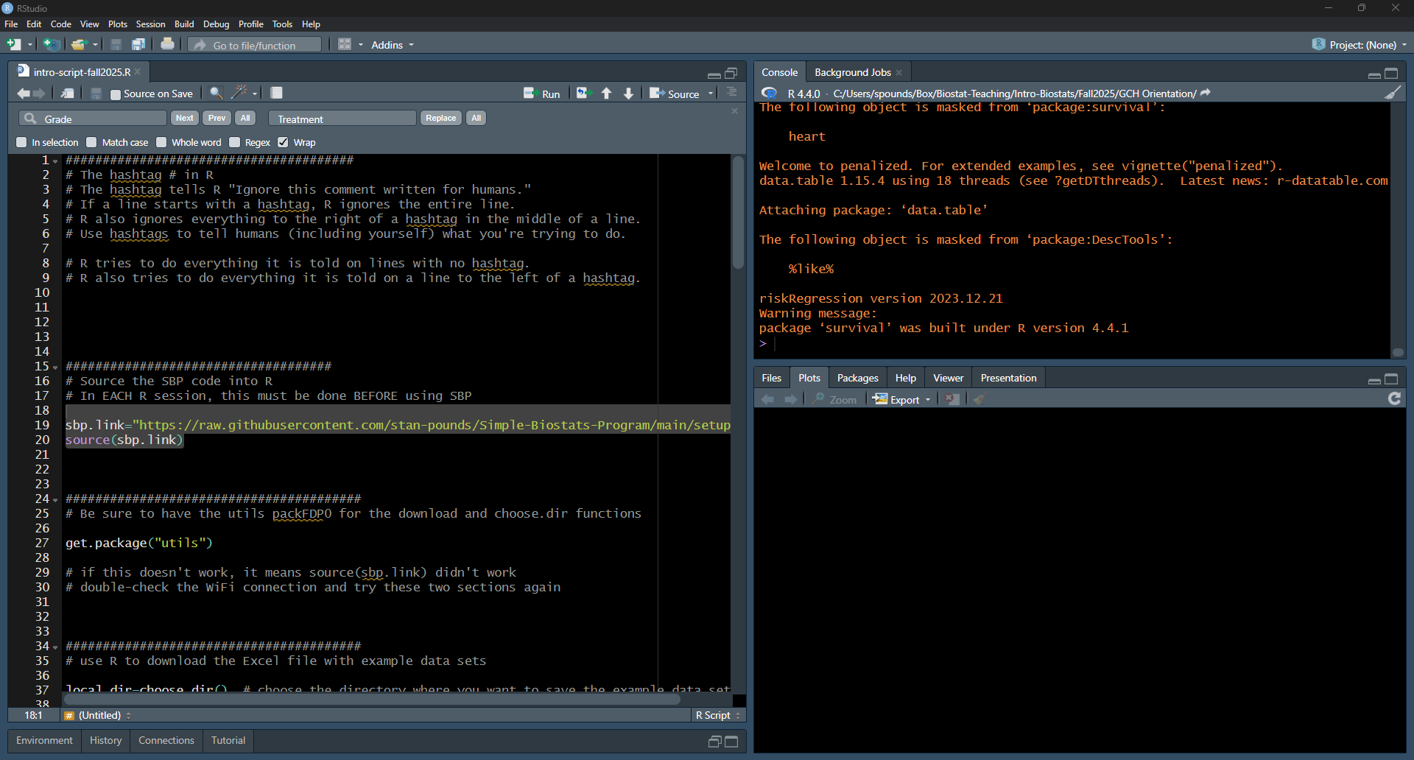
It will produce some messages: SBP is ready.

Slide 9
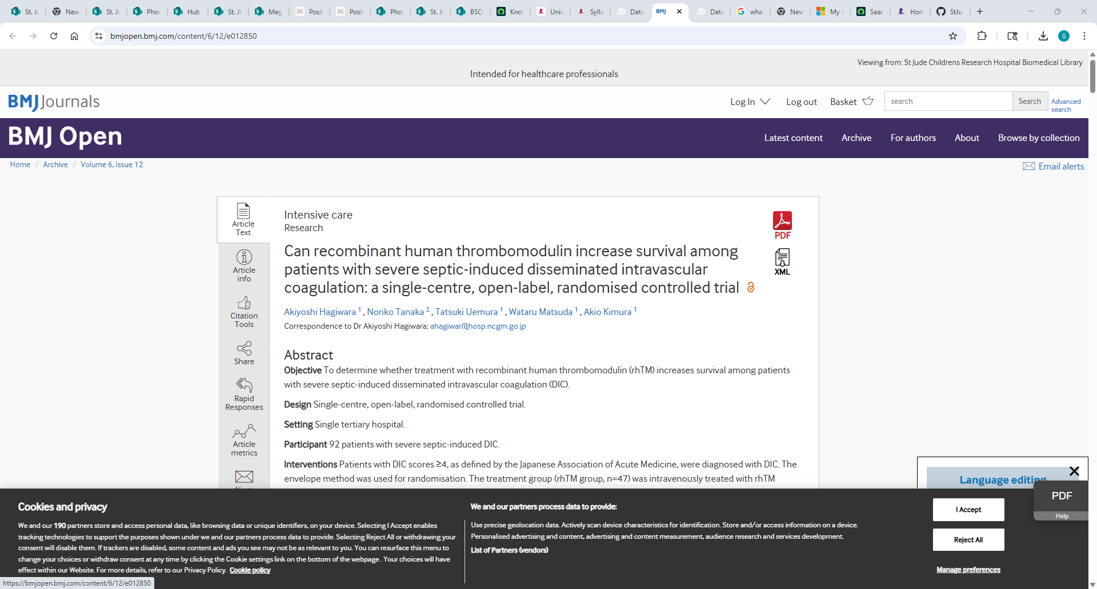
https://bmjopen.bmj.com/content/6/12/e012850

Slide 10
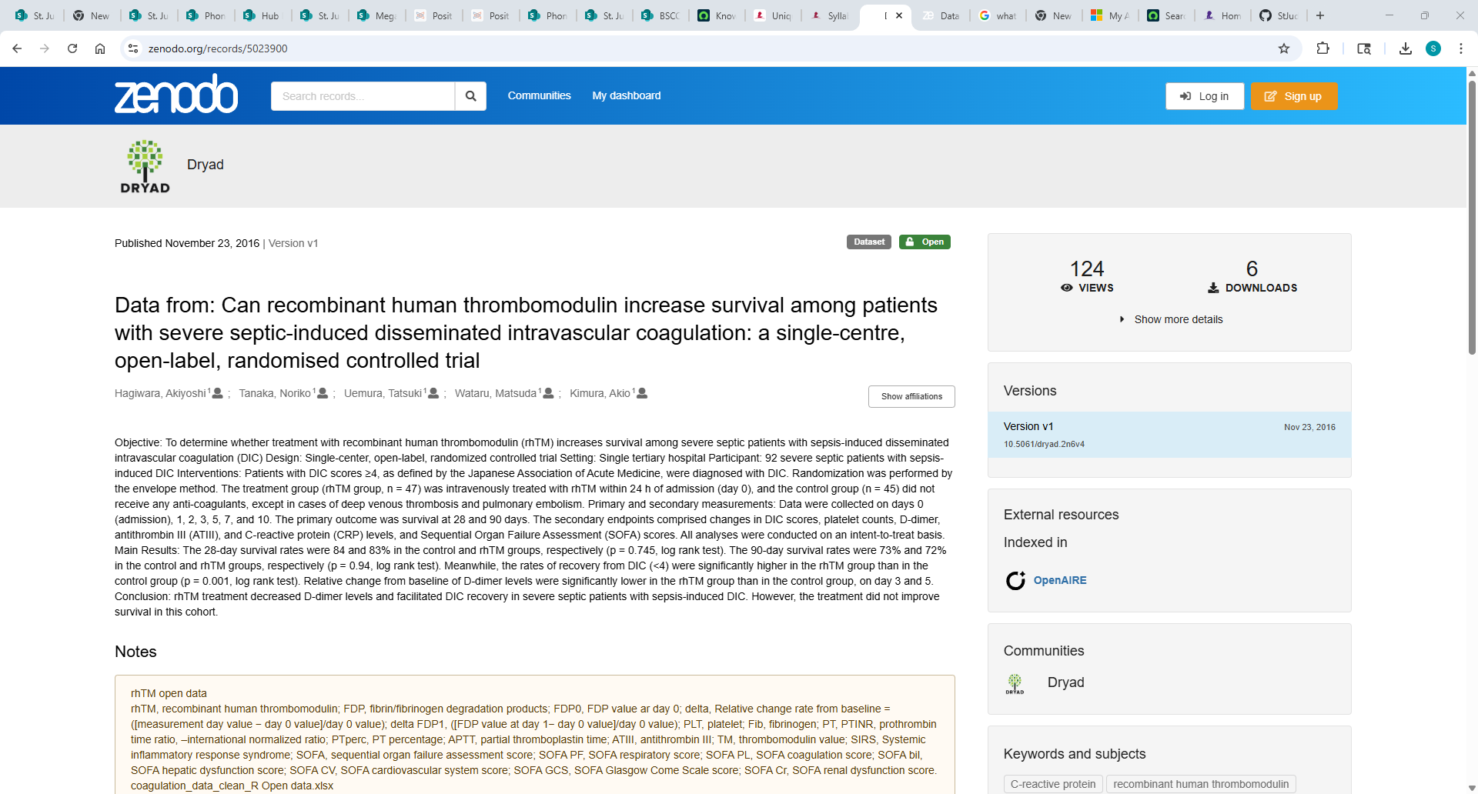
https://zenodo.org/records/5023900

Slide 11
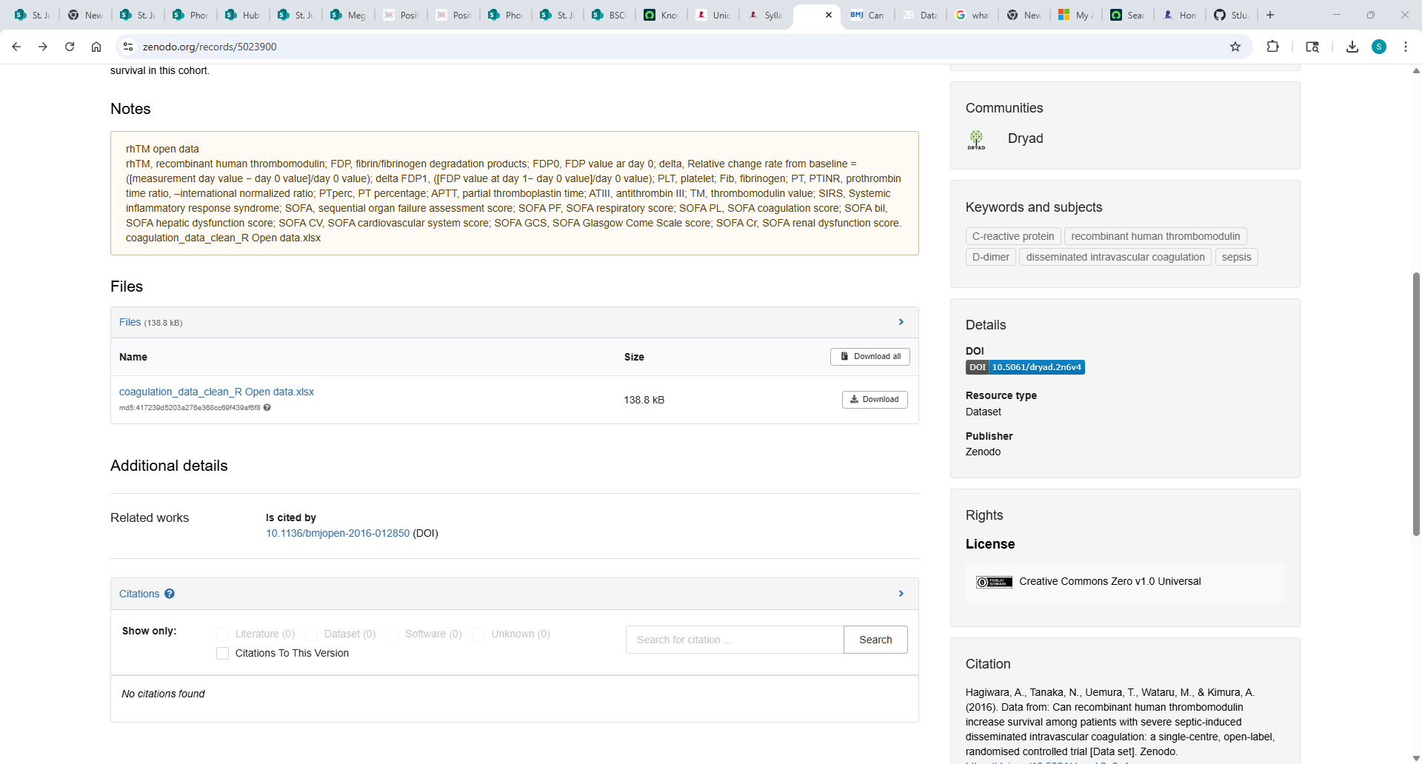
https://zenodo.org/records/5023900

Slide 12
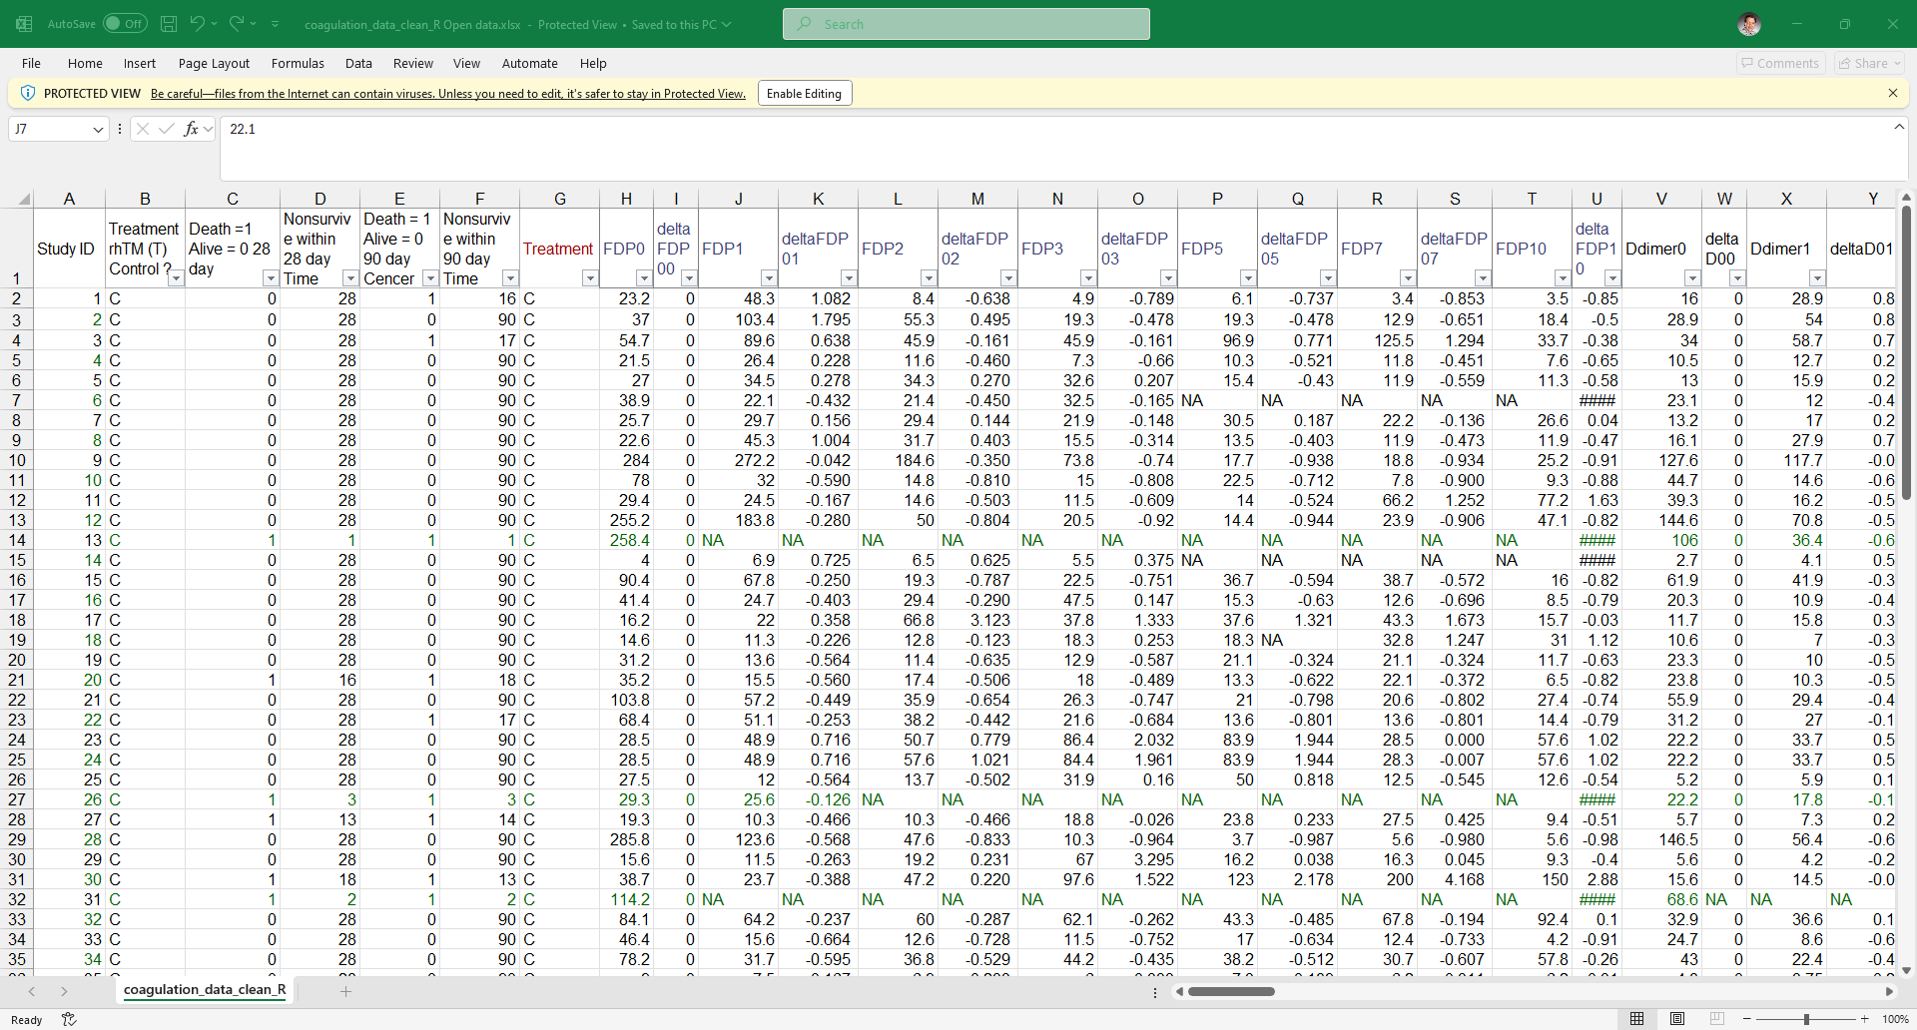
coagulation_data_clean_R Open data.xlsx

Slide 13
https://zenodo.org/records/5023900

Slide 14
Getting Started in Each New R Session
sbp.link="https://raw.githubusercontent.com/stan-pounds/Simple-Biostats-Program/main/setup-SBP.R")
source(sbp.link)
Read and name data
data.name = read.data()
# Choose file in pop-up window
Preview data
View(data.name)
colnames(data.name)
General Syntax
result = function(info1, info2, …)
# user chooses result name
Color Name Legend
show.colors()
show.palettes(number)
Descriptive Stats & Graphs
describe("column.name", data.name)
Copy Figure to Word
In the Plots tab, Click Export > Copy to Clipboard > Copy Plot.
Estimate One Population Parameter
estimate("column.name", data.name)
Copy Tabular Result to Word
word.table(result.name)
Compare a Variable across Groups
compare(variable.name~group.name, data.name)
Common Options
Narrative: txt = 0 (none), 1 (some), 2 … (more)
Tables: tbl = 0 (none), 1 (some), 2 … (more)
Figures: fig = 0 (none), 1 (some), 2 … (more)
Colors: clr = c("color1.name", "color2.name")
Colors: clr = "palette.name"
Output Labels: y.name, x.name, or grp.name = "name"
Correlate Two Numeric Variables
correlate(y.name~x.name, data.name)
Fit a Predictive Model
model(y.name~x1.name+x2.name, data.name)
Specific Options
estimate: null = number
correlate: line = NA (no line), 0 (flat line), 1 (fitted line)
Prepared by Stan Pounds 06/04/2024

Slide 15
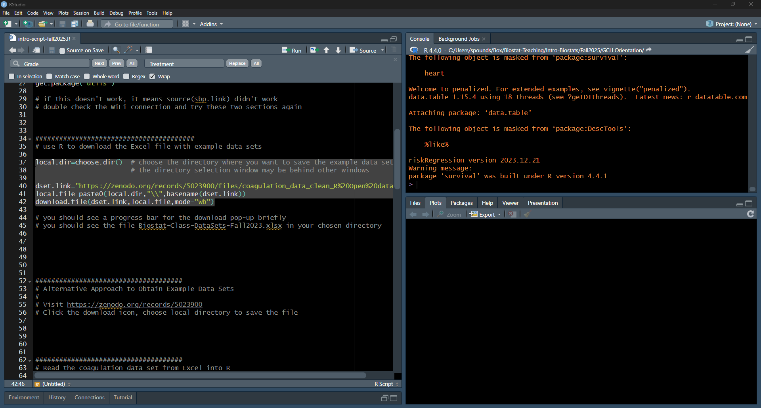
Highlight lines 37-42 and click run.

Slide 16
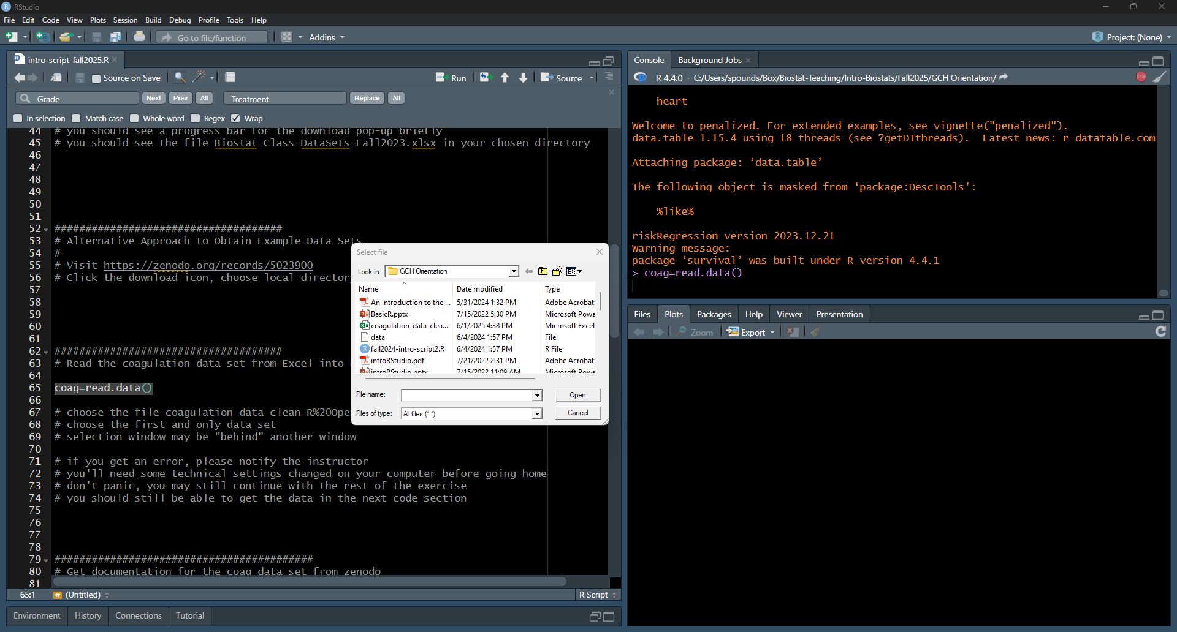
Highlight line 65 and click run, choose the file, click open.
A file browser window will open.
(It may be behind your window, look on the task bar at the bottom.)

Slide 17
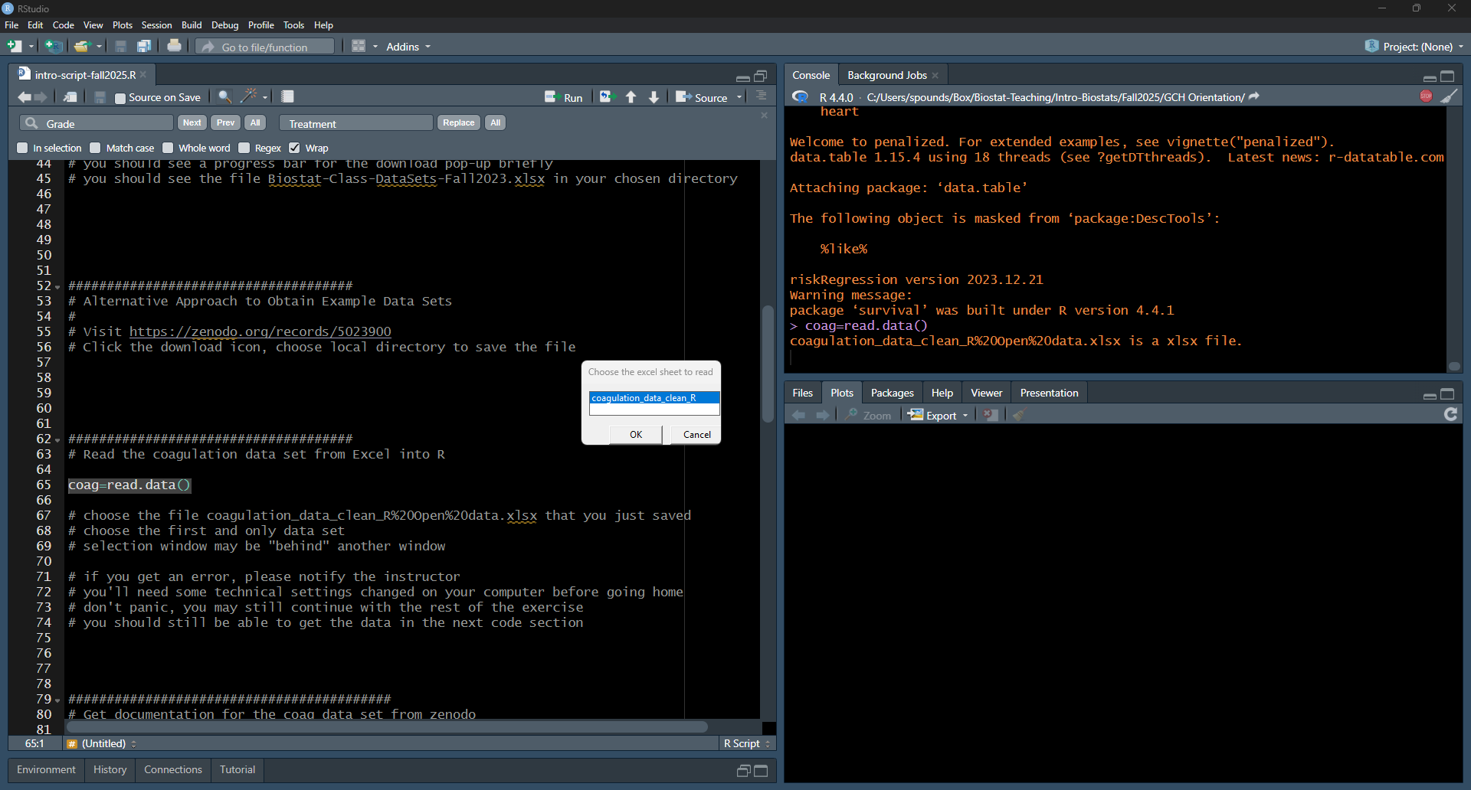
Choosecoagulation_data_clean_R. Click OK.
The selection window may pop up behind your R studio window. If that happens choose it off the task bar at the bottom of your screen.

Slide 18
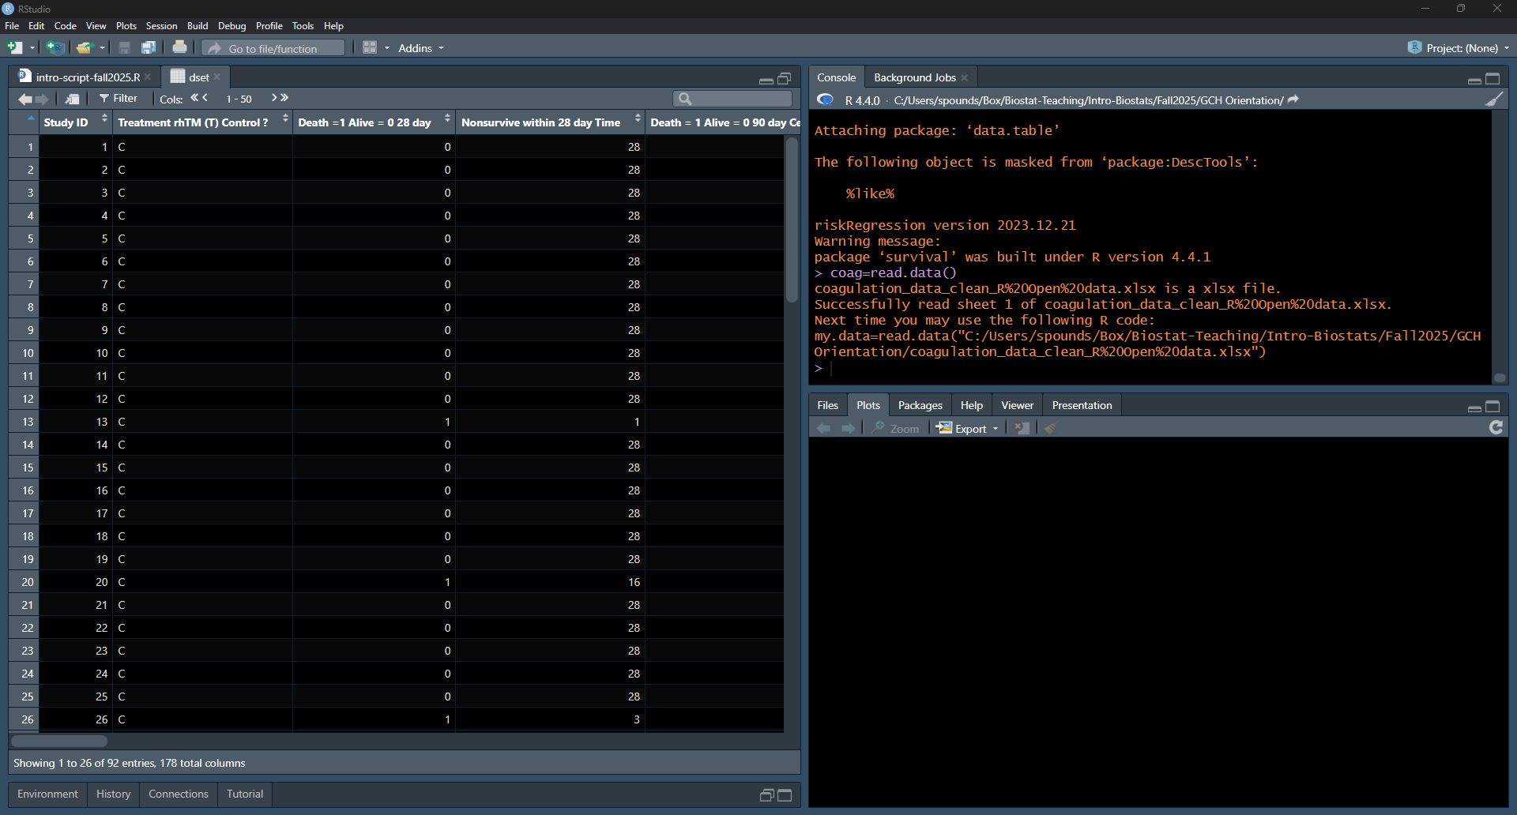
The data has been read into R. Check that it matches Excel data.

Slide 19
The data has been read into R. Check that it matches Excel data.

Slide 20
Scroll to the bottom in each view.

Slide 21
Go to the right in each view.

Slide 22
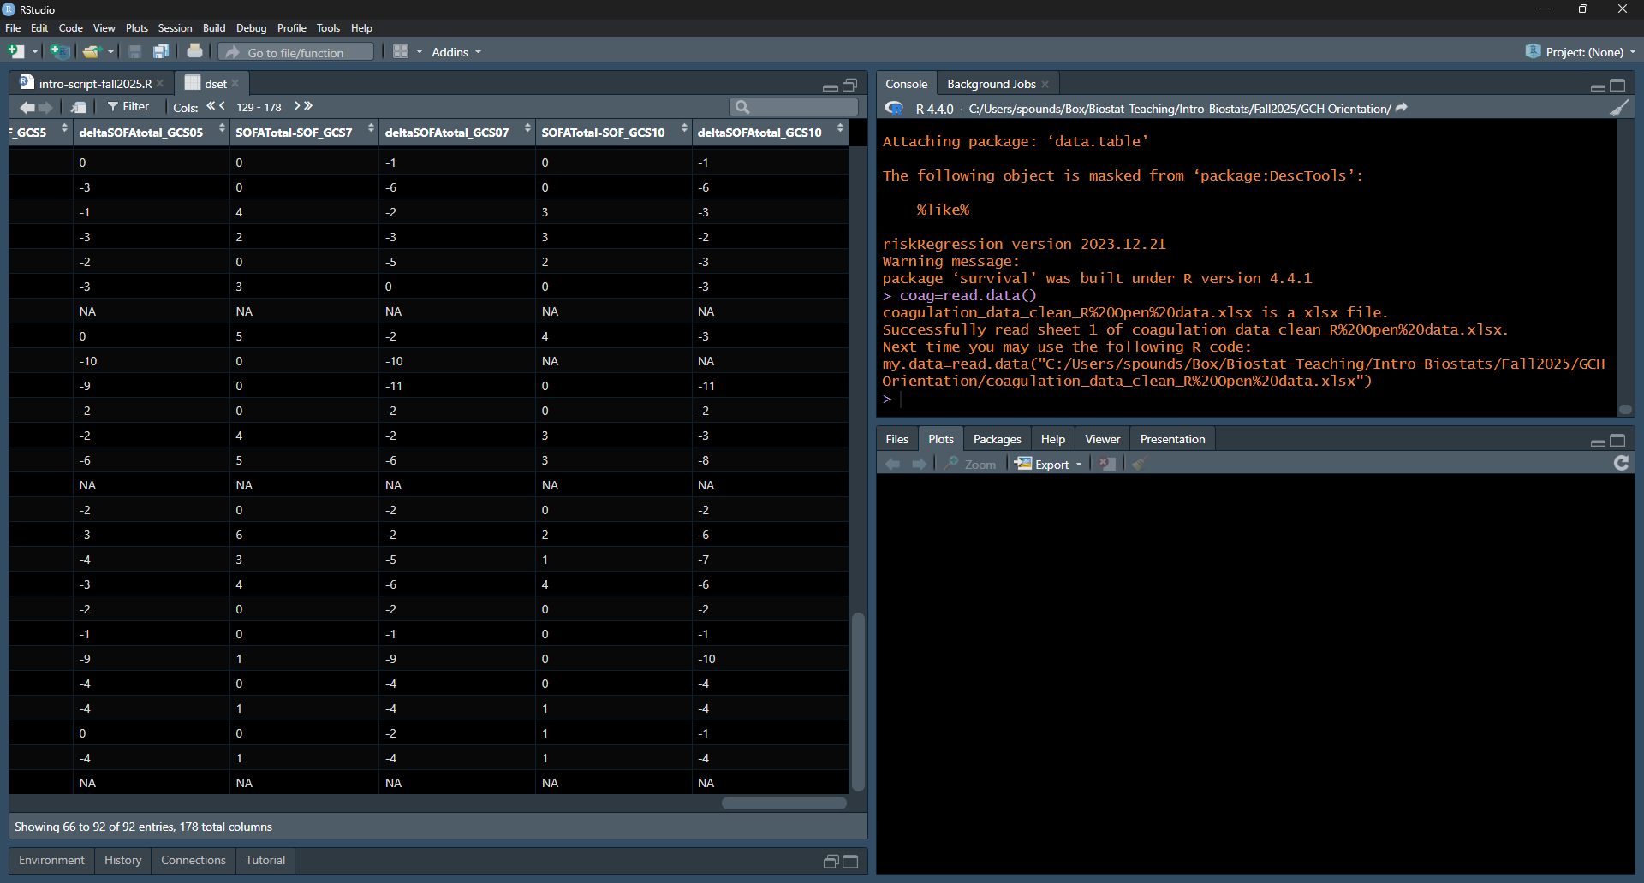
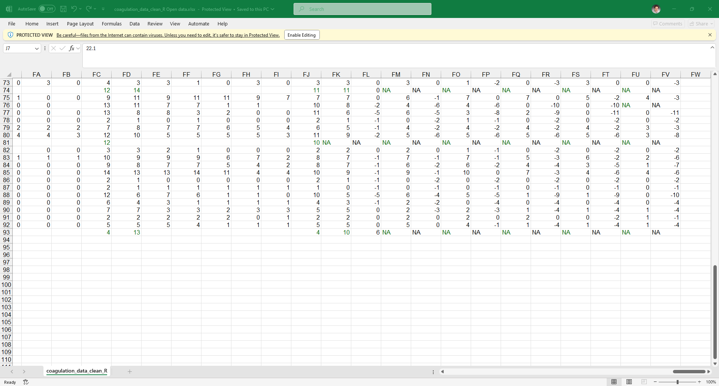
Check that the data matches.

Slide 23
Getting Started in Each New R Session
sbp.link="https://raw.githubusercontent.com/stan-pounds/Simple-Biostats-Program/main/setup-SBP.R")
source(sbp.link)
Read and name data
data.name = read.data()
# Choose file in pop-up window
Preview data
View(data.name)
colnames(data.name)
General Syntax
result = function(info1, info2, …)
# user chooses result name
Color Name Legend
show.colors()
show.palettes(number)
Descriptive Stats & Graphs
describe("column.name", data.name)
Copy Figure to Word
In the Plots tab, Click Export > Copy to Clipboard > Copy Plot.
Estimate One Population Parameter
estimate("column.name", data.name)
Copy Tabular Result to Word
word.table(result.name)
Compare a Variable across Groups
compare(variable.name~group.name, data.name)
Common Options
Narrative: txt = 0 (none), 1 (some), 2 … (more)
Tables: tbl = 0 (none), 1 (some), 2 … (more)
Figures: fig = 0 (none), 1 (some), 2 … (more)
Colors: clr = c("color1.name", "color2.name")
Colors: clr = "palette.name"
Output Labels: y.name, x.name, or grp.name = "name"
Correlate Two Numeric Variables
correlate(y.name~x.name, data.name)
Fit a Predictive Model
model(y.name~x1.name+x2.name, data.name)
Specific Options
estimate: null = number
correlate: line = NA (no line), 0 (flat line), 1 (fitted line)
Prepared by Stan Pounds 06/04/2024

Slide 24
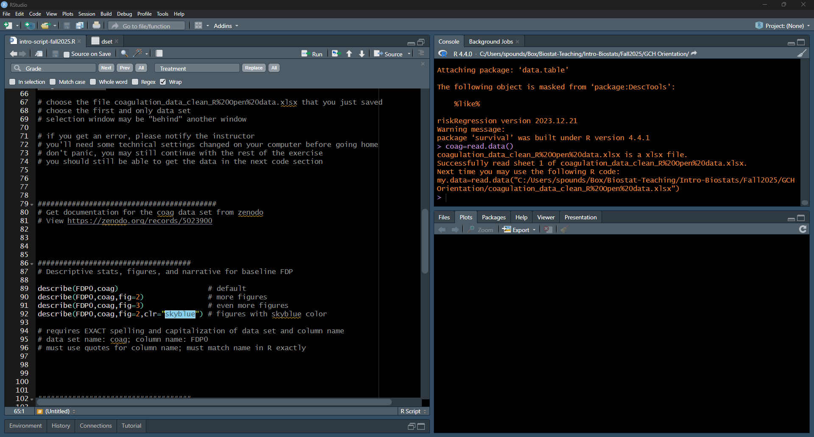
Click on the script window. Highlight and run line 89.

Slide 25
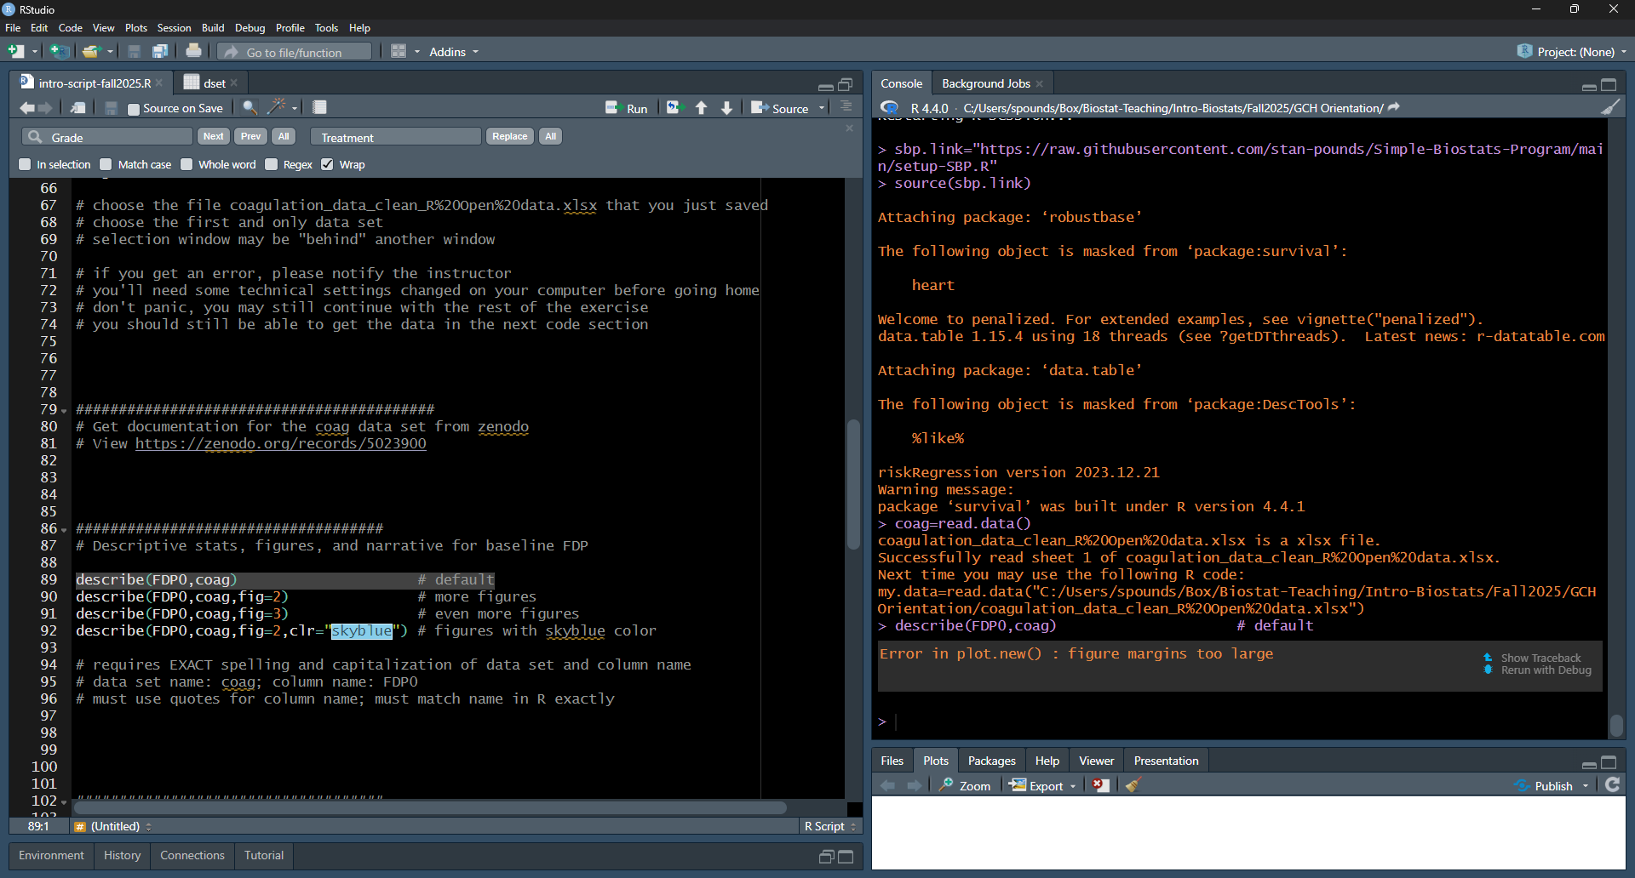
Error: figure margins too large.

Slide 26
Enlarge the “Plots” window and try again.

Slide 27
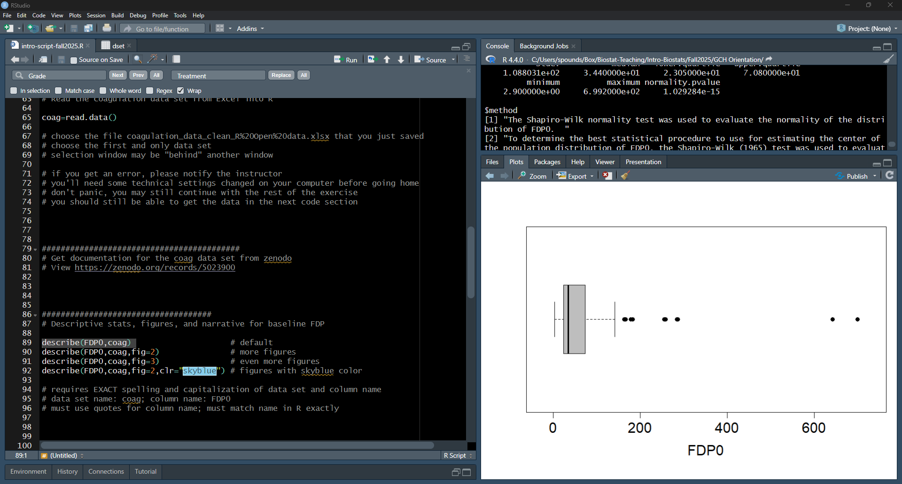

Slide 28
Enlarge the “Console” window.

Slide 29
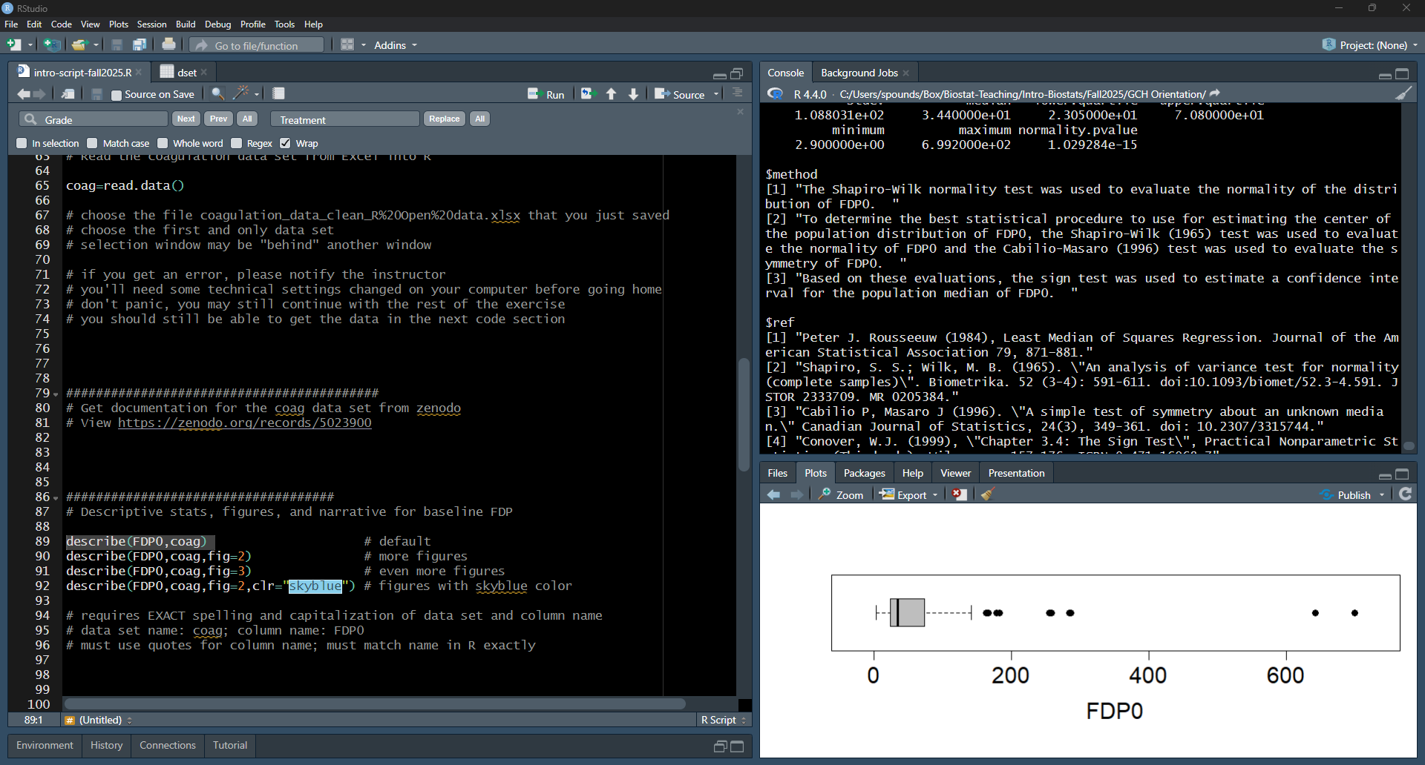
Scroll Up in the “Console” window.

Slide 30
See the text, methods, references. Just what you need!

Slide 31
Click the broom icon on the Plots window.

Slide 32
Getting Started in Each New R Session
sbp.link="https://raw.githubusercontent.com/stan-pounds/Simple-Biostats-Program/main/setup-SBP.R")
source(sbp.link)
Read and name data
data.name = read.data()
# Choose file in pop-up window
Preview data
View(data.name)
colnames(data.name)
General Syntax
result = function(info1, info2, …)
# user chooses result name
Color Name Legend
show.colors()
show.palettes(number)
Descriptive Stats & Graphs
describe("column.name", data.name)
Copy Figure to Word
In the Plots tab, Click Export > Copy to Clipboard > Copy Plot.
Estimate One Population Parameter
estimate("column.name", data.name)
Copy Tabular Result to Word
word.table(result.name)
Compare a Variable across Groups
compare(variable.name~group.name, data.name)
Common Options
Narrative: txt = 0 (none), 1 (some), 2 … (more)
Tables: tbl = 0 (none), 1 (some), 2 … (more)
Figures: fig = 0 (none), 1 (some), 2 … (more)
Colors: clr = c("color1.name", "color2.name")
Colors: clr = "palette.name"
Output Labels: y.name, x.name, or grp.name = "name"
Correlate Two Numeric Variables
correlate(y.name~x.name, data.name)
Fit a Predictive Model
model(y.name~x1.name+x2.name, data.name)
Specific Options
estimate: null = number
correlate: line = NA (no line), 0 (flat line), 1 (fitted line)
Prepared by Stan Pounds 06/04/2024

Slide 33
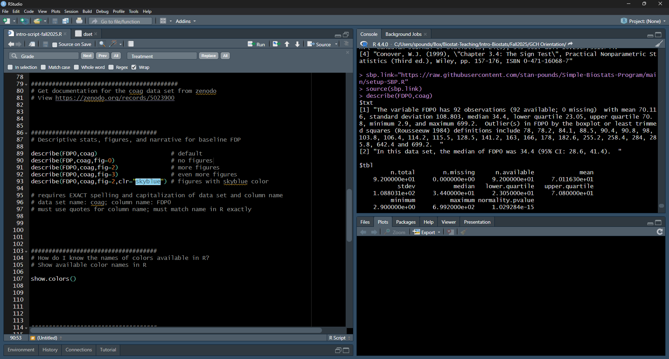
Highlight and run line 90. We get text & tables but no figure.

Slide 34
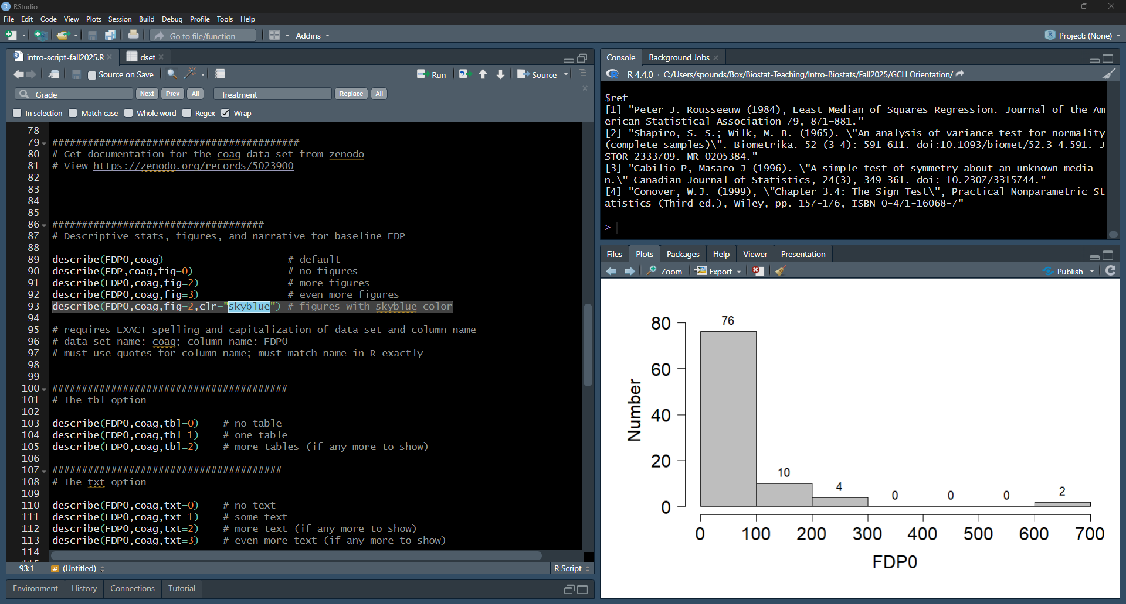
Highlight and run lines 91-92. We get more figures.

Slide 35
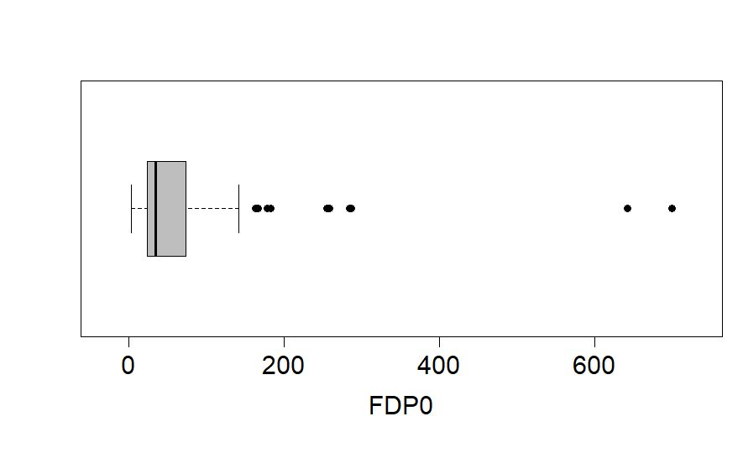
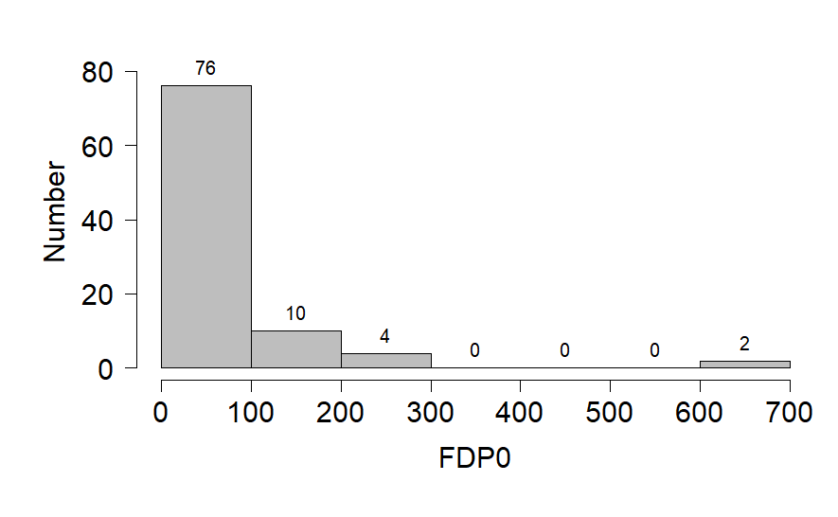
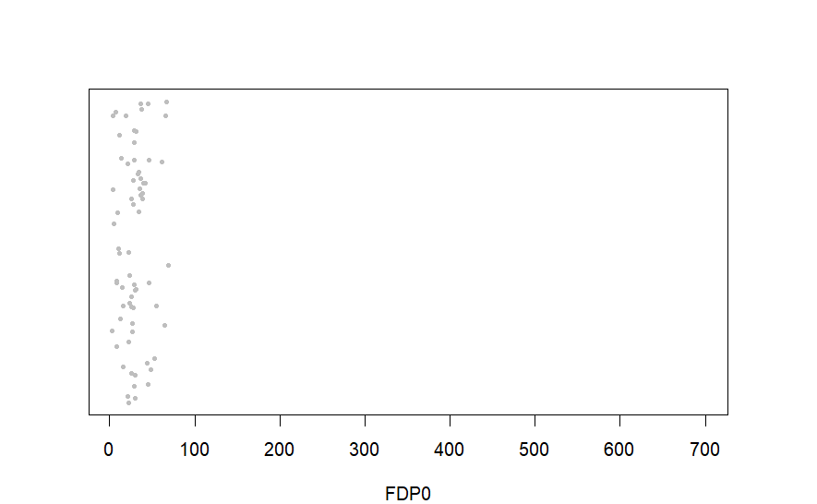

Slide 36
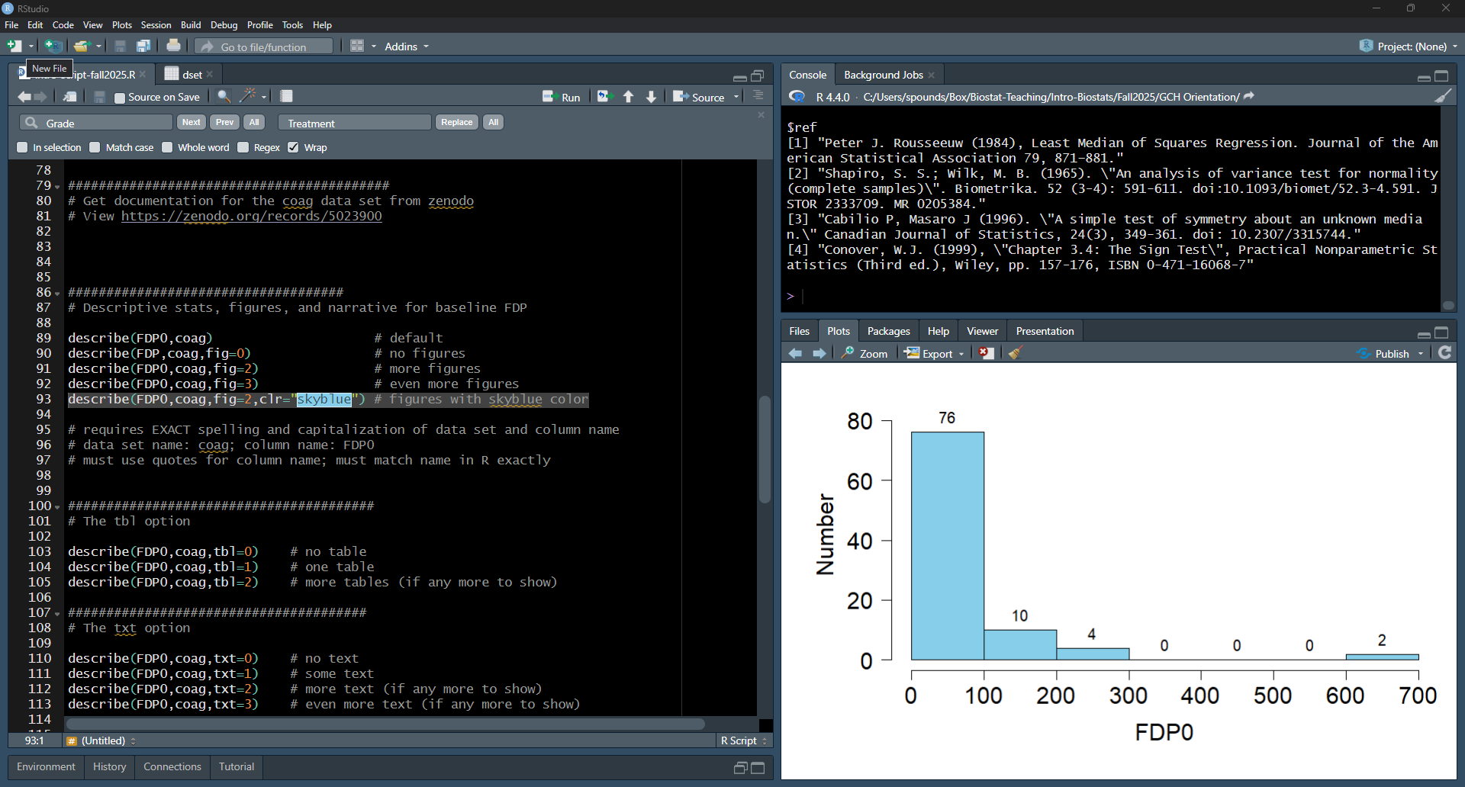
Highlight and run line 93. We get figures with skyblue color.

Slide 37
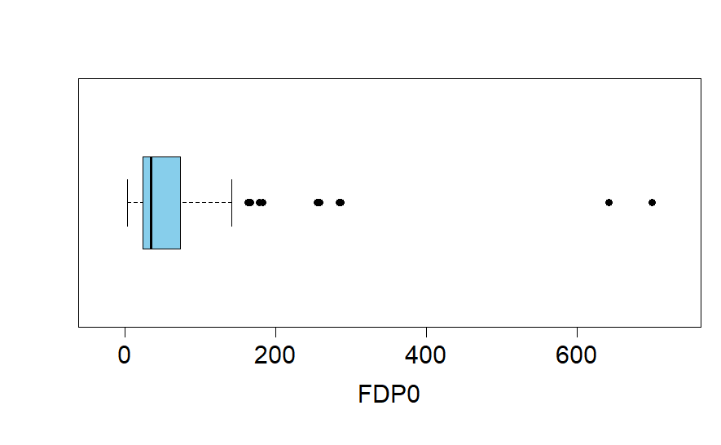
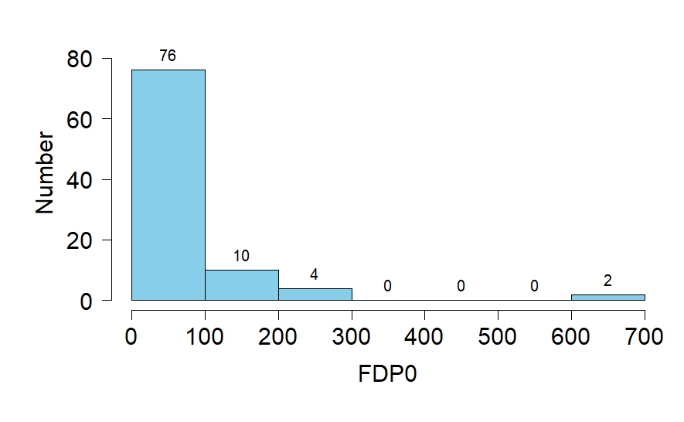

Slide 38
Getting Started in Each New R Session
sbp.link="https://raw.githubusercontent.com/stan-pounds/Simple-Biostats-Program/main/setup-SBP.R")
source(sbp.link)
Read and name data
data.name = read.data()
# Choose file in pop-up window
Preview data
View(data.name)
colnames(data.name)
General Syntax
result = function(info1, info2, …)
# user chooses result name
Color Name Legend
show.colors()
show.palettes(number)
Descriptive Stats & Graphs
describe("column.name", data.name)
Copy Figure to Word
In the Plots tab, Click Export > Copy to Clipboard > Copy Plot.
Estimate One Population Parameter
estimate("column.name", data.name)
Copy Tabular Result to Word
word.table(result.name)
Compare a Variable across Groups
compare(variable.name~group.name, data.name)
Common Options
Narrative: txt = 0 (none), 1 (some), 2 … (more)
Tables: tbl = 0 (none), 1 (some), 2 … (more)
Figures: fig = 0 (none), 1 (some), 2 … (more)
Colors: clr = c("color1.name", "color2.name")
Colors: clr = "palette.name"
Output Labels: y.name, x.name, or grp.name = "name"
Correlate Two Numeric Variables
correlate(y.name~x.name, data.name)
Fit a Predictive Model
model(y.name~x1.name+x2.name, data.name)
Specific Options
estimate: null = number
correlate: line = NA (no line), 0 (flat line), 1 (fitted line)
Prepared by Stan Pounds 06/04/2024

Slide 39
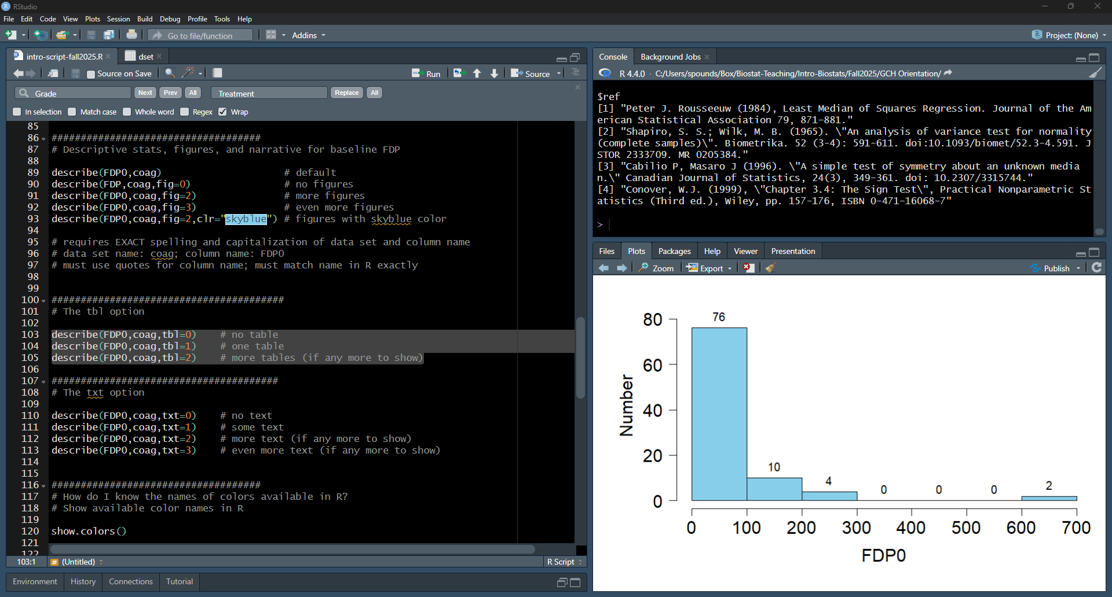
Highlight and run lines 103-105 one at a time.

Slide 40
Getting Started in Each New R Session
sbp.link="https://raw.githubusercontent.com/stan-pounds/Simple-Biostats-Program/main/setup-SBP.R")
source(sbp.link)
Read and name data
data.name = read.data()
# Choose file in pop-up window
Preview data
View(data.name)
colnames(data.name)
General Syntax
result = function(info1, info2, …)
# user chooses result name
Color Name Legend
show.colors()
show.palettes(number)
Descriptive Stats & Graphs
describe("column.name", data.name)
Copy Figure to Word
In the Plots tab, Click Export > Copy to Clipboard > Copy Plot.
Estimate One Population Parameter
estimate("column.name", data.name)
Copy Tabular Result to Word
word.table(result.name)
Compare a Variable across Groups
compare(variable.name~group.name, data.name)
Common Options
Narrative: txt = 0 (none), 1 (some), 2 … (more)
Tables: tbl = 0 (none), 1 (some), 2 … (more)
Figures: fig = 0 (none), 1 (some), 2 … (more)
Colors: clr = c("color1.name", "color2.name")
Colors: clr = "palette.name"
Output Labels: y.name, x.name, or grp.name = "name"
Correlate Two Numeric Variables
correlate(y.name~x.name, data.name)
Fit a Predictive Model
model(y.name~x1.name+x2.name, data.name)
Specific Options
estimate: null = number
correlate: line = NA (no line), 0 (flat line), 1 (fitted line)
Prepared by Stan Pounds 06/04/2024

Slide 41
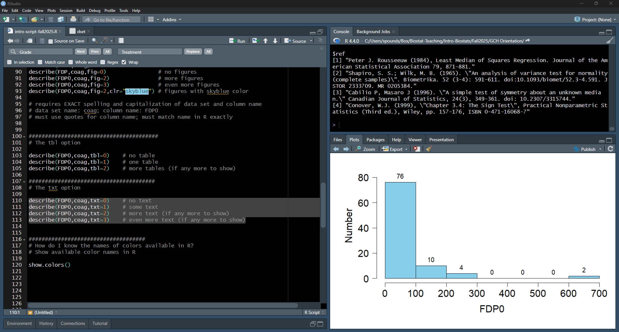
Highlight and run lines 110-113 one at a time.

Slide 42
Getting Started in Each New R Session
sbp.link="https://raw.githubusercontent.com/stan-pounds/Simple-Biostats-Program/main/setup-SBP.R")
source(sbp.link)
Read and name data
data.name = read.data()
# Choose file in pop-up window
Preview data
View(data.name)
colnames(data.name)
General Syntax
result = function(info1, info2, …)
# user chooses result name
Color Name Legend
show.colors()
show.palettes(number)
Descriptive Stats & Graphs
describe("column.name", data.name)
Copy Figure to Word
In the Plots tab, Click Export > Copy to Clipboard > Copy Plot.
Estimate One Population Parameter
estimate("column.name", data.name)
Copy Tabular Result to Word
word.table(result.name)
Compare a Variable across Groups
compare(variable.name~group.name, data.name)
Common Options
Narrative: txt = 0 (none), 1 (some), 2 … (more)
Tables: tbl = 0 (none), 1 (some), 2 … (more)
Figures: fig = 0 (none), 1 (some), 2 … (more)
Colors: clr = c("color1.name", "color2.name")
Colors: clr = "palette.name"
Output Labels: y.name, x.name, or grp.name = "name"
Correlate Two Numeric Variables
correlate(y.name~x.name, data.name)
Fit a Predictive Model
model(y.name~x1.name+x2.name, data.name)
Specific Options
estimate: null = number
correlate: line = NA (no line), 0 (flat line), 1 (fitted line)
Prepared by Stan Pounds 06/04/2024

Slide 43
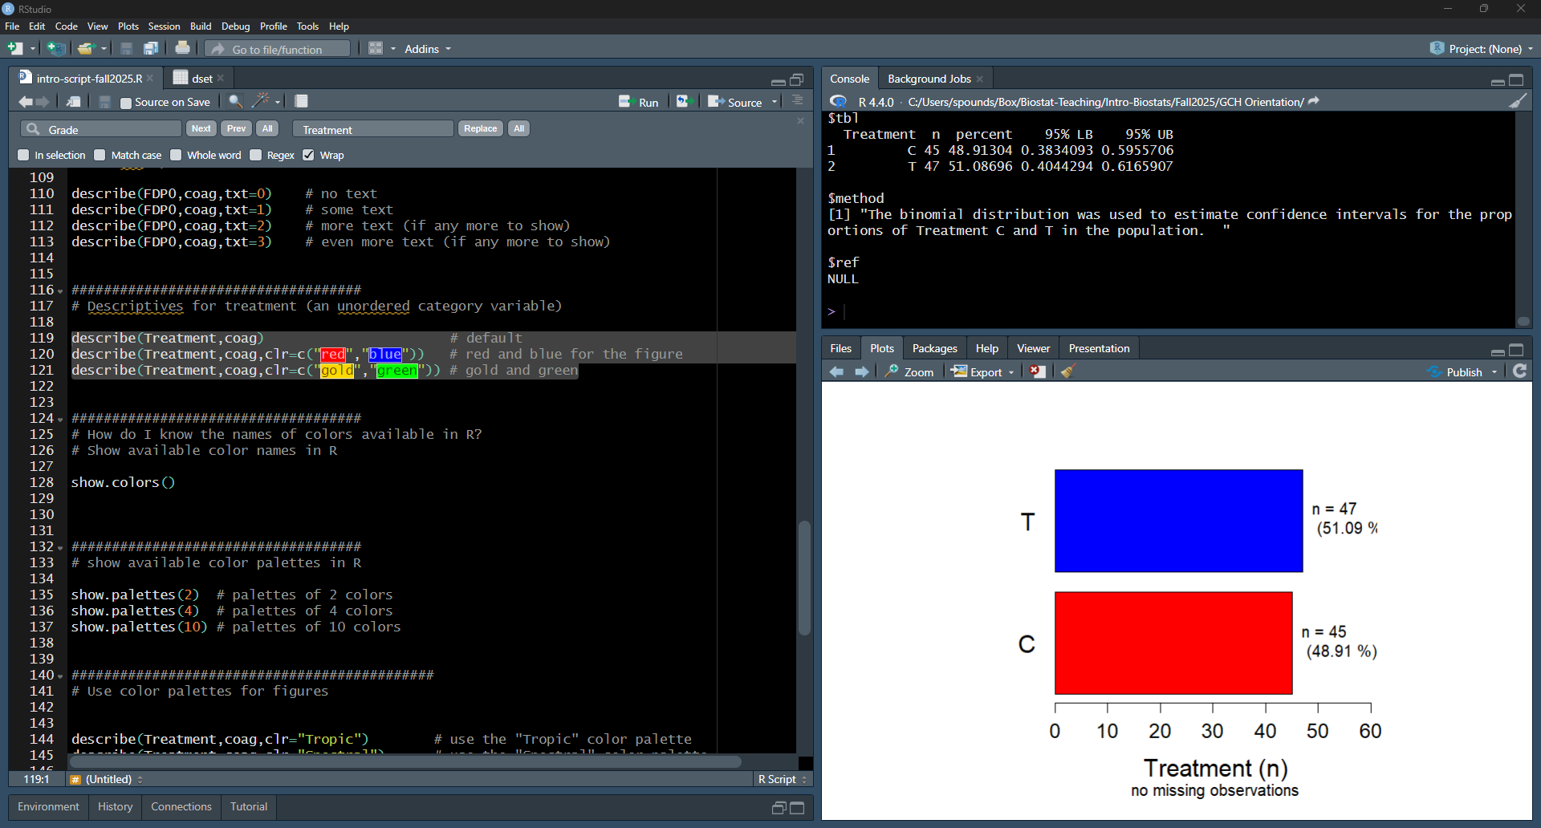
Highlight and run lines 119-121 one at a time.

Slide 44
Getting Started in Each New R Session
sbp.link="https://raw.githubusercontent.com/stan-pounds/Simple-Biostats-Program/main/setup-SBP.R")
source(sbp.link)
Read and name data
data.name = read.data()
# Choose file in pop-up window
Preview data
View(data.name)
colnames(data.name)
General Syntax
result = function(info1, info2, …)
# user chooses result name
Color Name Legend
show.colors()
show.palettes(number)
Descriptive Stats & Graphs
describe("column.name", data.name)
Copy Figure to Word
In the Plots tab, Click Export > Copy to Clipboard > Copy Plot.
Estimate One Population Parameter
estimate("column.name", data.name)
Copy Tabular Result to Word
word.table(result.name)
Compare a Variable across Groups
compare(variable.name~group.name, data.name)
Common Options
Narrative: txt = 0 (none), 1 (some), 2 … (more)
Tables: tbl = 0 (none), 1 (some), 2 … (more)
Figures: fig = 0 (none), 1 (some), 2 … (more)
Colors: clr = c("color1.name", "color2.name")
Colors: clr = "palette.name"
Output Labels: y.name, x.name, or grp.name = "name"
Correlate Two Numeric Variables
correlate(y.name~x.name, data.name)
Fit a Predictive Model
model(y.name~x1.name+x2.name, data.name)
Specific Options
estimate: null = number
correlate: line = NA (no line), 0 (flat line), 1 (fitted line)
Prepared by Stan Pounds 06/04/2024

Slide 45
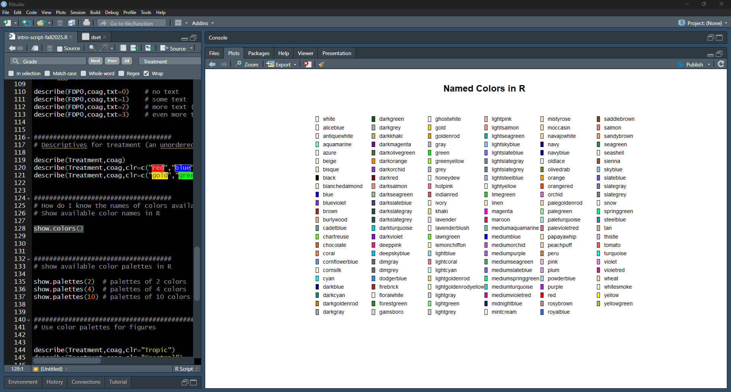
Highlight and run line 128. Get a color legend.

Slide 46
Getting Started in Each New R Session
sbp.link="https://raw.githubusercontent.com/stan-pounds/Simple-Biostats-Program/main/setup-SBP.R")
source(sbp.link)
Read and name data
data.name = read.data()
# Choose file in pop-up window
Preview data
View(data.name)
colnames(data.name)
General Syntax
result = function(info1, info2, …)
# user chooses result name
Color Name Legend
show.colors()
show.palettes(number)
Descriptive Stats & Graphs
describe("column.name", data.name)
Copy Figure to Word
In the Plots tab, Click Export > Copy to Clipboard > Copy Plot.
Estimate One Population Parameter
estimate("column.name", data.name)
Copy Tabular Result to Word
word.table(result.name)
Compare a Variable across Groups
compare(variable.name~group.name, data.name)
Common Options
Narrative: txt = 0 (none), 1 (some), 2 … (more)
Tables: tbl = 0 (none), 1 (some), 2 … (more)
Figures: fig = 0 (none), 1 (some), 2 … (more)
Colors: clr = c("color1.name", "color2.name")
Colors: clr = "palette.name"
Output Labels: y.name, x.name, or grp.name = "name"
Correlate Two Numeric Variables
correlate(y.name~x.name, data.name)
Fit a Predictive Model
model(y.name~x1.name+x2.name, data.name)
Specific Options
estimate: null = number
correlate: line = NA (no line), 0 (flat line), 1 (fitted line)
Prepared by Stan Pounds 06/04/2024

Slide 47
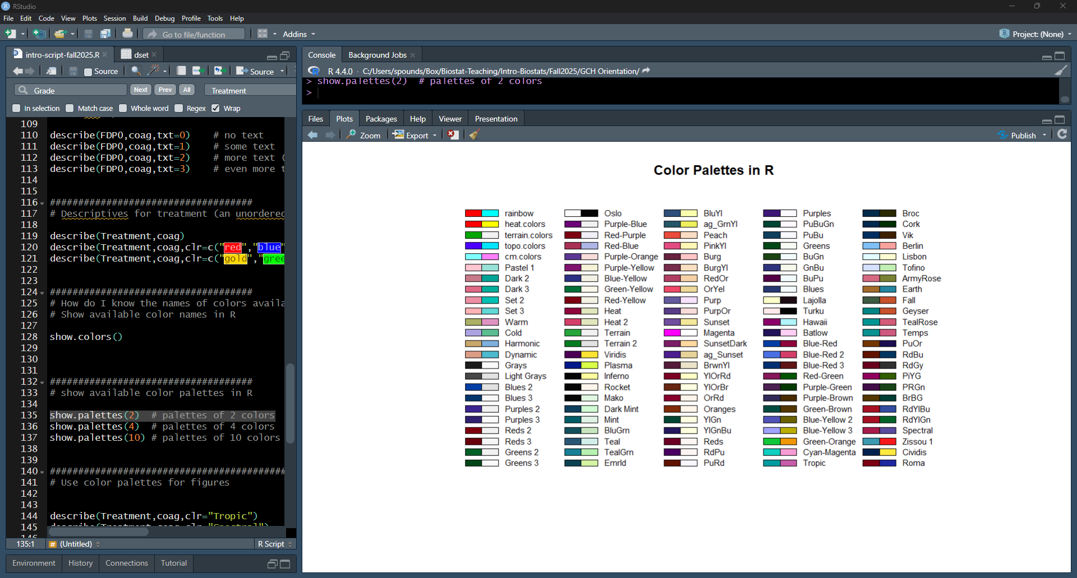
Highlight and Run line 135, get palettes of two colors.

Slide 48
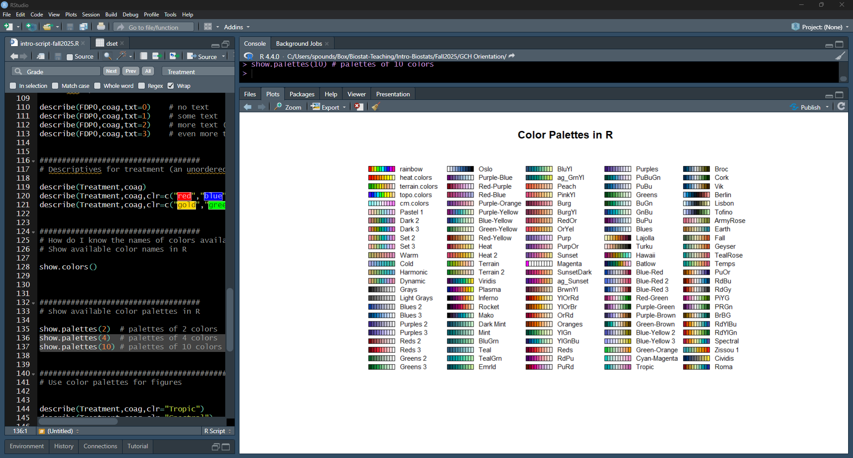
Run lines 136-137. See palettes of more colors.

Slide 49
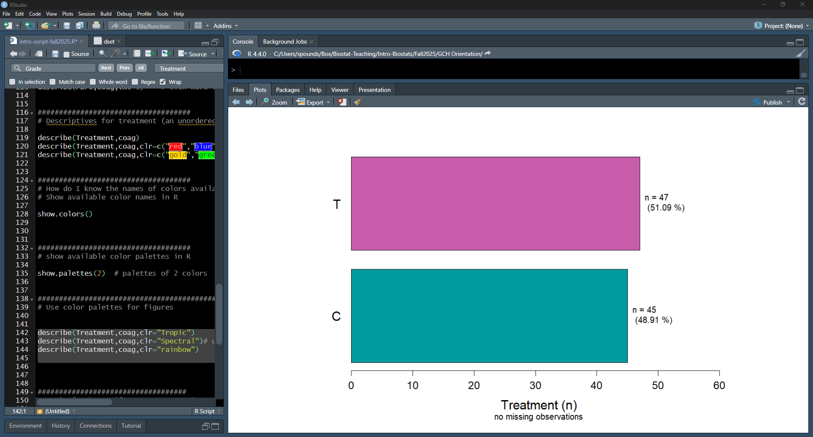
Run lines 142-144. See how palettes change figures.

Slide 50
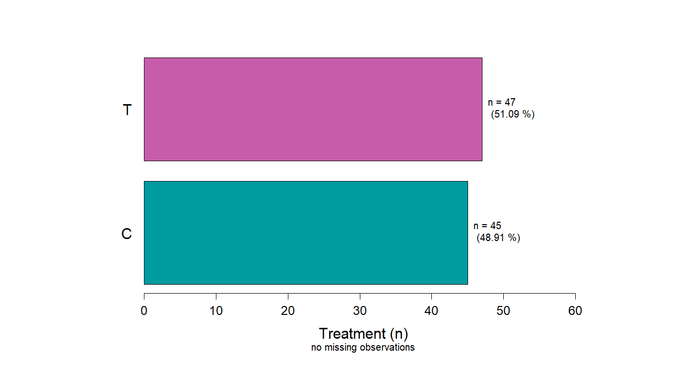
Option clr=“Tropic”

Slide 51
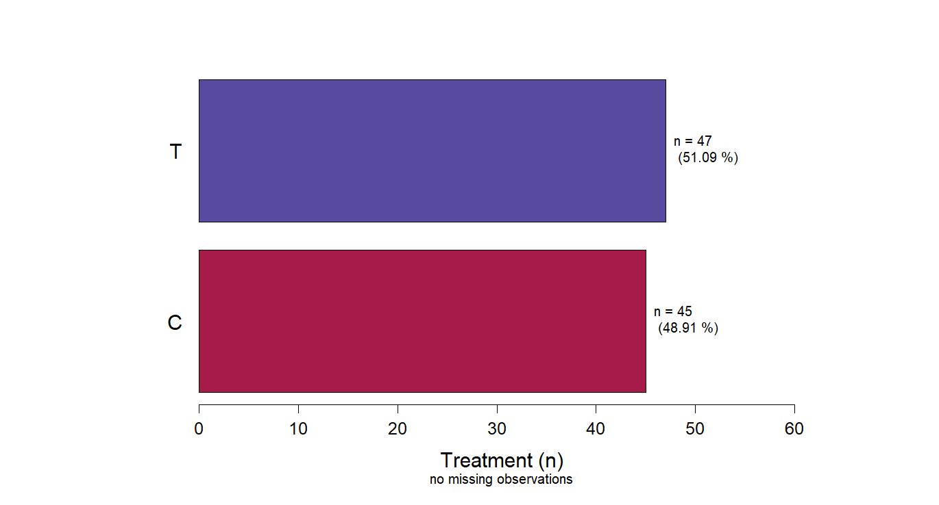
Option clr=“Spectral”

Slide 52
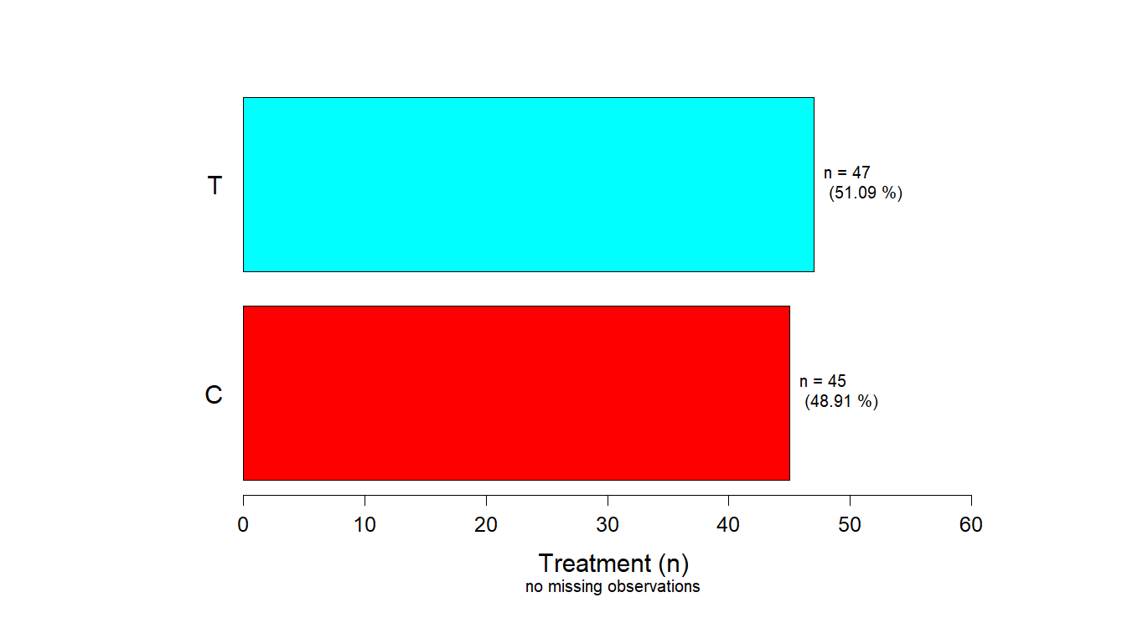
Option clr=“rainbow”

Slide 53
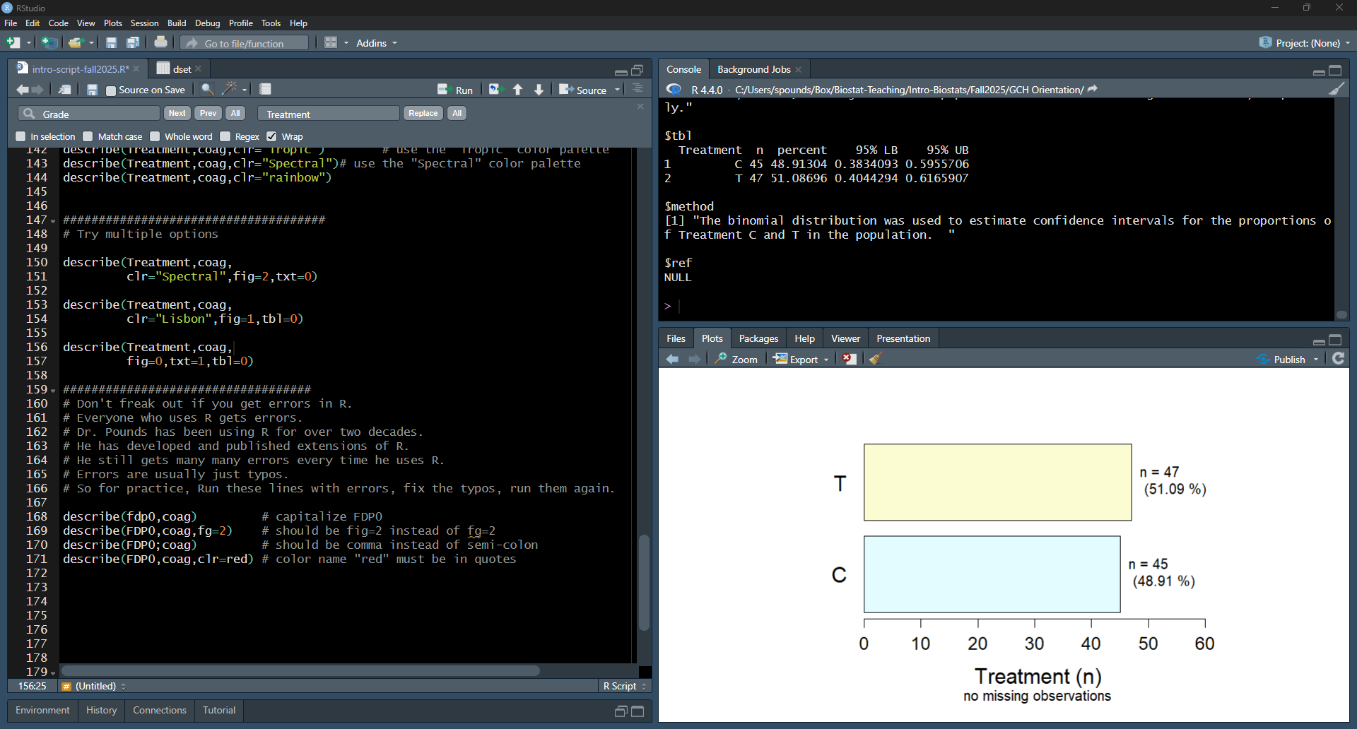
Try multiple options … highlight and run sections.

Slide 54
Getting Started in Each New R Session
sbp.link="https://raw.githubusercontent.com/stan-pounds/Simple-Biostats-Program/main/setup-SBP.R")
source(sbp.link)
Read and name data
data.name = read.data()
# Choose file in pop-up window
Preview data
View(data.name)
colnames(data.name)
General Syntax
result = function(info1, info2, …)
# user chooses result name
Color Name Legend
show.colors()
show.palettes(number)
Descriptive Stats & Graphs
describe("column.name", data.name)
Copy Figure to Word
In the Plots tab, Click Export > Copy to Clipboard > Copy Plot.
Estimate One Population Parameter
estimate("column.name", data.name)
Copy Tabular Result to Word
word.table(result.name)
Compare a Variable across Groups
compare(variable.name~group.name, data.name)
Common Options
Narrative: txt = 0 (none), 1 (some), 2 … (more)
Tables: tbl = 0 (none), 1 (some), 2 … (more)
Figures: fig = 0 (none), 1 (some), 2 … (more)
Colors: clr = c("color1.name", "color2.name")
Colors: clr = "palette.name"
Output Labels: y.name, x.name, or grp.name = "name"
Correlate Two Numeric Variables
correlate(y.name~x.name, data.name)
Fit a Predictive Model
model(y.name~x1.name+x2.name, data.name)
Specific Options
estimate: null = number
correlate: line = NA (no line), 0 (flat line), 1 (fitted line)
Prepared by Stan Pounds 06/04/2024

Slide 55
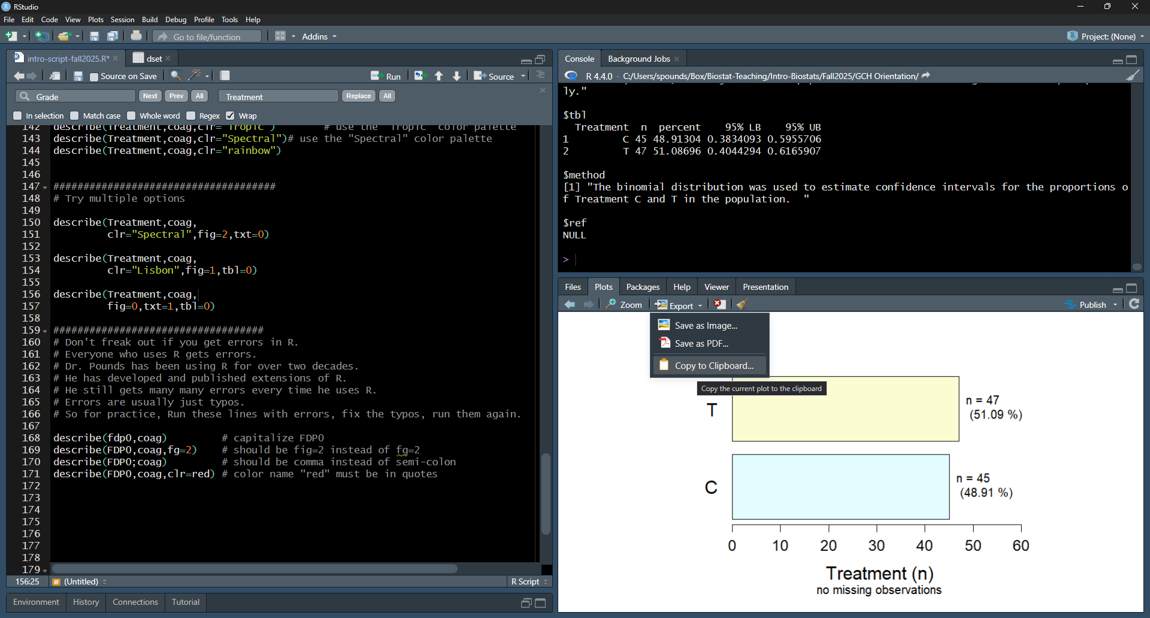
Go to Export … Copy to Clipboard.

Slide 56
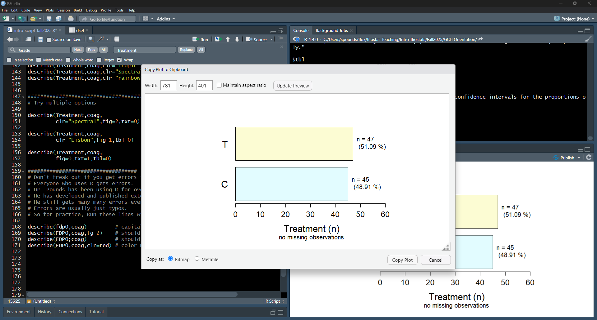
Click Copy Plot.

Slide 57
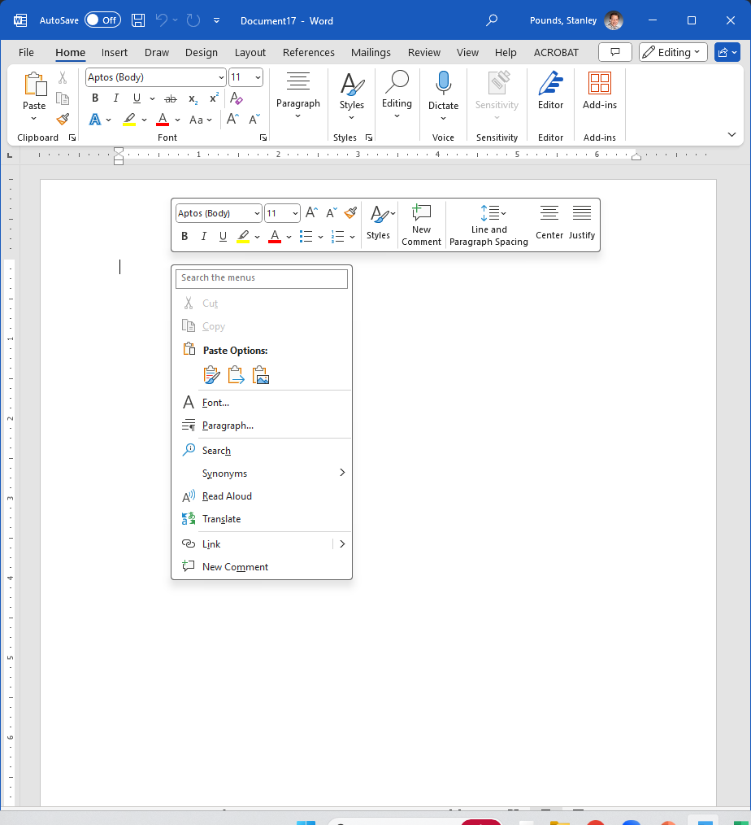
Open Word.
Right click.
Choose the paste picture icon.
Resize as you see fit.

Slide 58
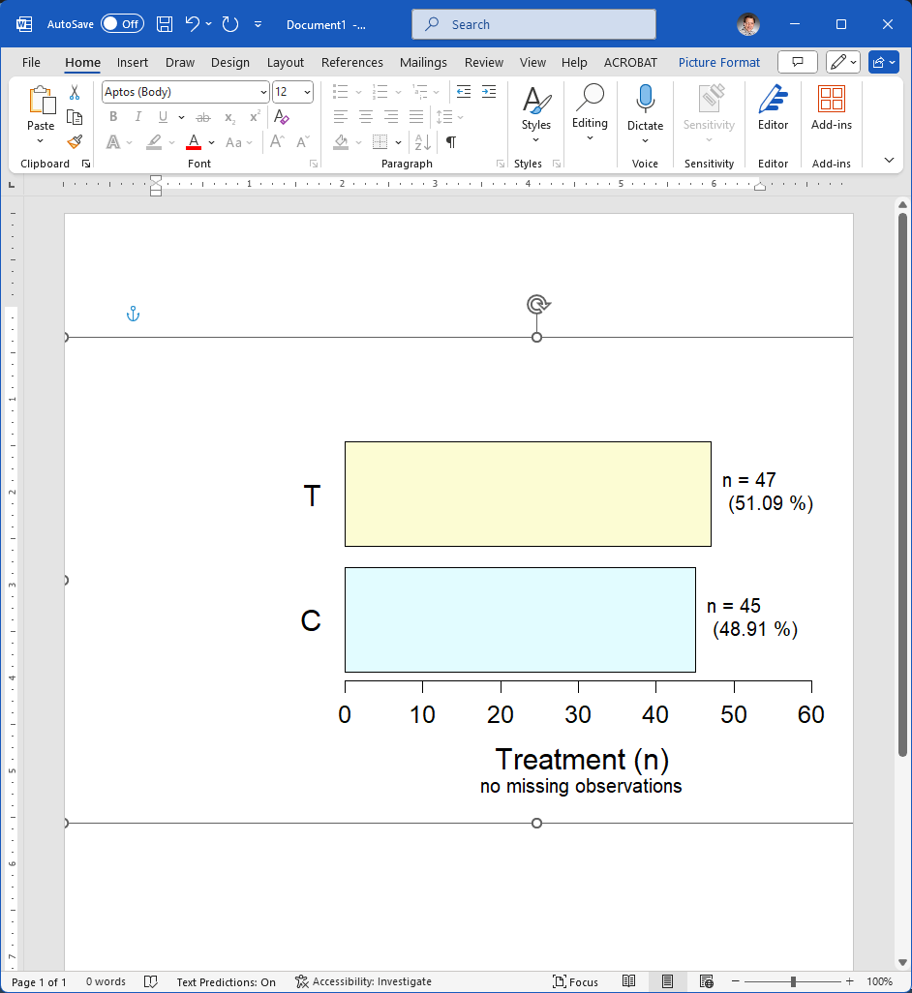
CONGRATULATIONS!
You’ve generated a graph and copied it into Word!

Slide 59
Getting Started in Each New R Session
sbp.link="https://raw.githubusercontent.com/stan-pounds/Simple-Biostats-Program/main/setup-SBP.R")
source(sbp.link)
Read and name data
data.name = read.data()
# Choose file in pop-up window
Preview data
View(data.name)
colnames(data.name)
General Syntax
result = function(info1, info2, …)
# user chooses result name
Color Name Legend
show.colors()
show.palettes(number)
Descriptive Stats & Graphs
describe("column.name", data.name)
Copy Figure to Word
In the Plots tab, Click Export > Copy to Clipboard > Copy Plot.
Estimate One Population Parameter
estimate("column.name", data.name)
Copy Tabular Result to Word
word.table(result.name)
Compare a Variable across Groups
compare(variable.name~group.name, data.name)
Common Options
Narrative: txt = 0 (none), 1 (some), 2 … (more)
Tables: tbl = 0 (none), 1 (some), 2 … (more)
Figures: fig = 0 (none), 1 (some), 2 … (more)
Colors: clr = c("color1.name", "color2.name")
Colors: clr = "palette.name"
Output Labels: y.name, x.name, or grp.name = "name"
Correlate Two Numeric Variables
correlate(y.name~x.name, data.name)
Fit a Predictive Model
model(y.name~x1.name+x2.name, data.name)
Specific Options
estimate: null = number
correlate: line = NA (no line), 0 (flat line), 1 (fitted line)
Prepared by Stan Pounds 06/04/2024

Slide 60
Getting Started in Each New R Session
sbp.link="https://raw.githubusercontent.com/stan-pounds/Simple-Biostats-Program/main/setup-SBP.R")
source(sbp.link)
Read and name data
data.name = read.data()
# Choose file in pop-up window
Preview data
View(data.name)
colnames(data.name)
General Syntax
result = function(info1, info2, …)
# user chooses result name
Color Name Legend
show.colors()
show.palettes(number)
Descriptive Stats & Graphs
describe("column.name", data.name)
Copy Figure to Word
In the Plots tab, Click Export > Copy to Clipboard > Copy Plot.
Estimate One Population Parameter
estimate("column.name", data.name)
Copy Tabular Result to Word
word.table(result.name)
Compare a Variable across Groups
compare(variable.name~group.name, data.name)
Common Options
Narrative: txt = 0 (none), 1 (some), 2 … (more)
Tables: tbl = 0 (none), 1 (some), 2 … (more)
Figures: fig = 0 (none), 1 (some), 2 … (more)
Colors: clr = c("color1.name", "color2.name")
Colors: clr = "palette.name"
Output Labels: y.name, x.name, or grp.name = "name"
Correlate Two Numeric Variables
correlate(y.name~x.name, data.name)
Fit a Predictive Model
model(y.name~x1.name+x2.name, data.name)
Specific Options
estimate: null = number
correlate: line = NA (no line), 0 (flat line), 1 (fitted line)
Prepared by Stan Pounds 06/04/2024

Slide 61
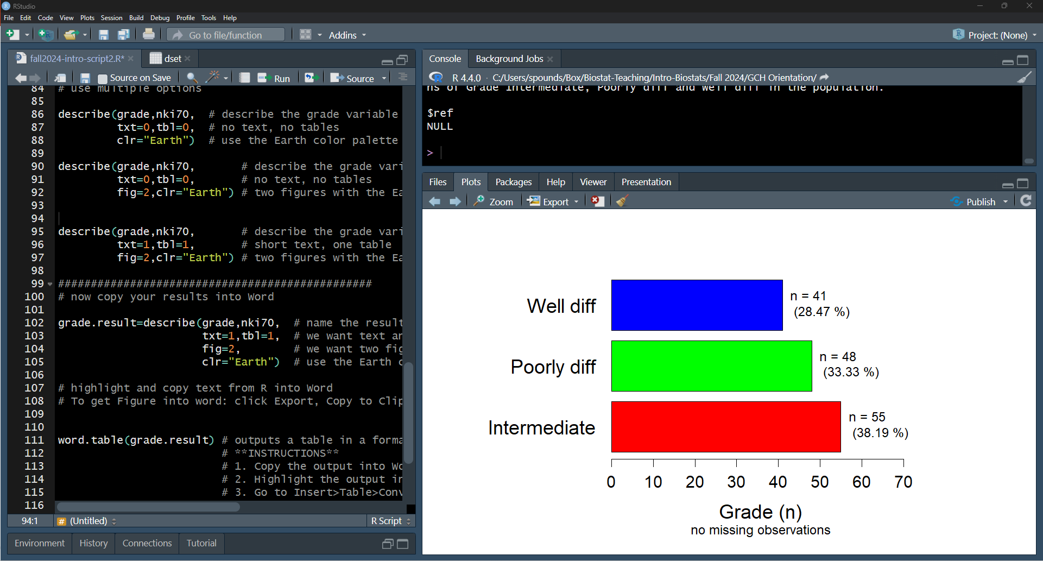
Highlight and run lines 102-105.

Slide 62
Getting Started in Each New R Session
sbp.link="https://raw.githubusercontent.com/stan-pounds/Simple-Biostats-Program/main/setup-SBP.R")
source(sbp.link)
Read and name data
data.name = read.data()
# Choose file in pop-up window
Preview data
View(data.name)
colnames(data.name)
General Syntax
result = function(info1, info2, …)
# user chooses result name
Color Name Legend
show.colors()
show.palettes(number)
Descriptive Stats & Graphs
describe("column.name", data.name)
Copy Figure to Word
In the Plots tab, Click Export > Copy to Clipboard > Copy Plot.
Estimate One Population Parameter
estimate("column.name", data.name)
Copy Tabular Result to Word
word.table(result.name)
Compare a Variable across Groups
compare(variable.name~group.name, data.name)
Common Options
Narrative: txt = 0 (none), 1 (some), 2 … (more)
Tables: tbl = 0 (none), 1 (some), 2 … (more)
Figures: fig = 0 (none), 1 (some), 2 … (more)
Colors: clr = c("color1.name", "color2.name")
Colors: clr = "palette.name"
Output Labels: y.name, x.name, or grp.name = "name"
Correlate Two Numeric Variables
correlate(y.name~x.name, data.name)
Fit a Predictive Model
model(y.name~x1.name+x2.name, data.name)
Specific Options
estimate: null = number
correlate: line = NA (no line), 0 (flat line), 1 (fitted line)
Prepared by Stan Pounds 06/04/2024

Slide 63
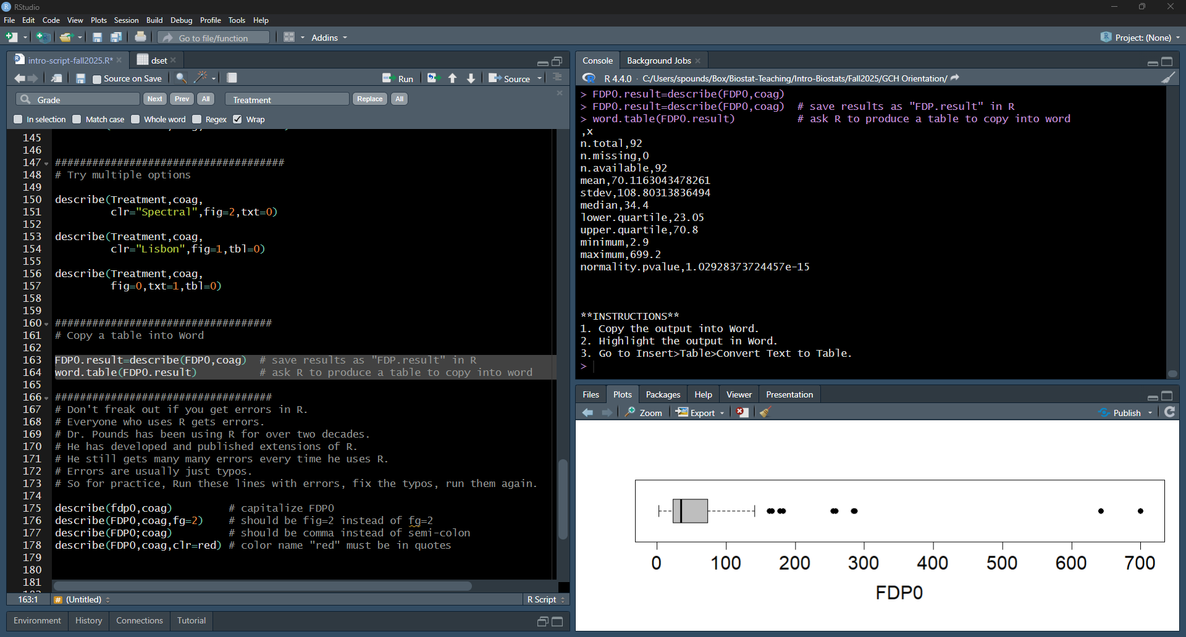
Run line 111. See the output in the Console.

Slide 64
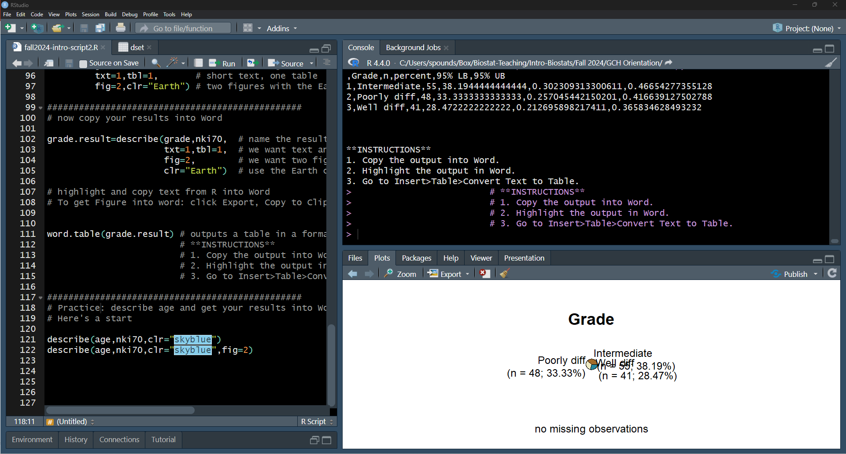
Note the instructions in the output.

Slide 65
Note and follow the instructions in the output.

Slide 66
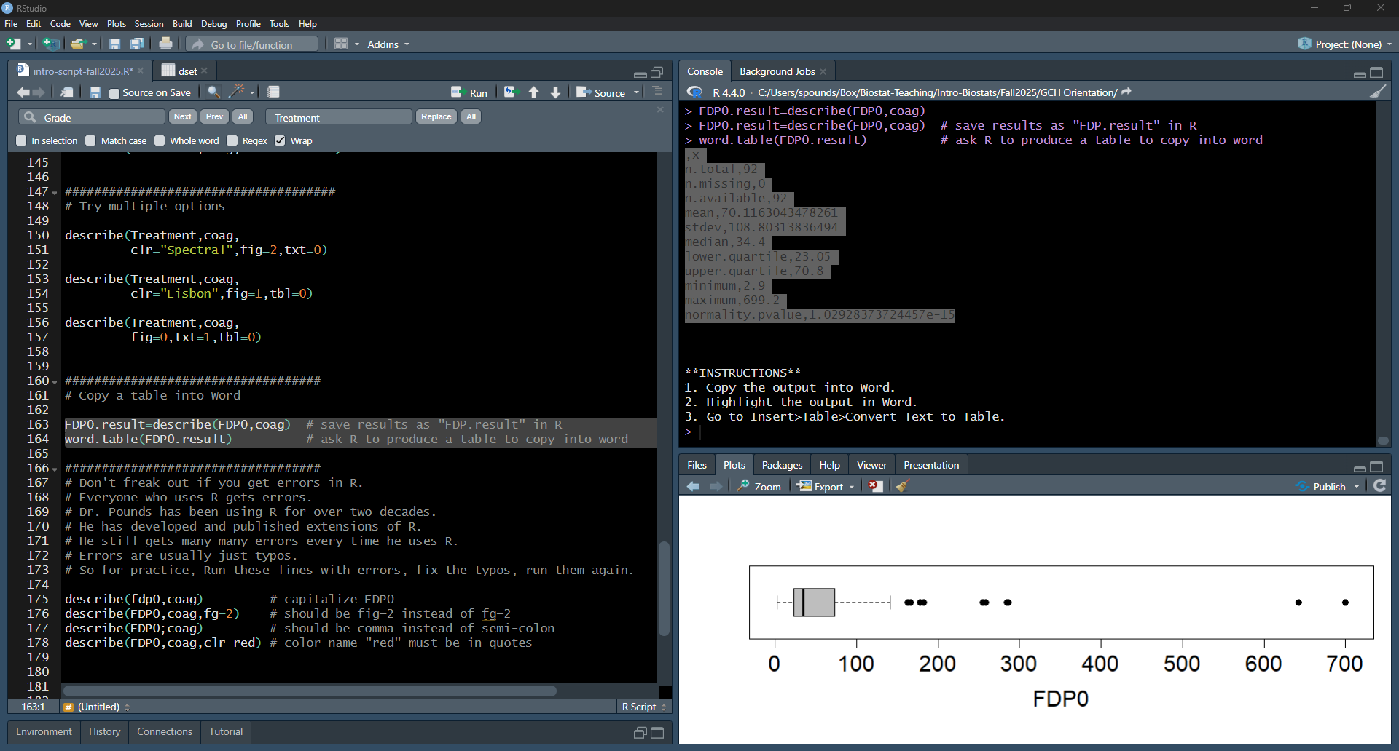
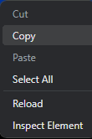
Highlight the output. Right Click. Choose Copy.

Slide 67
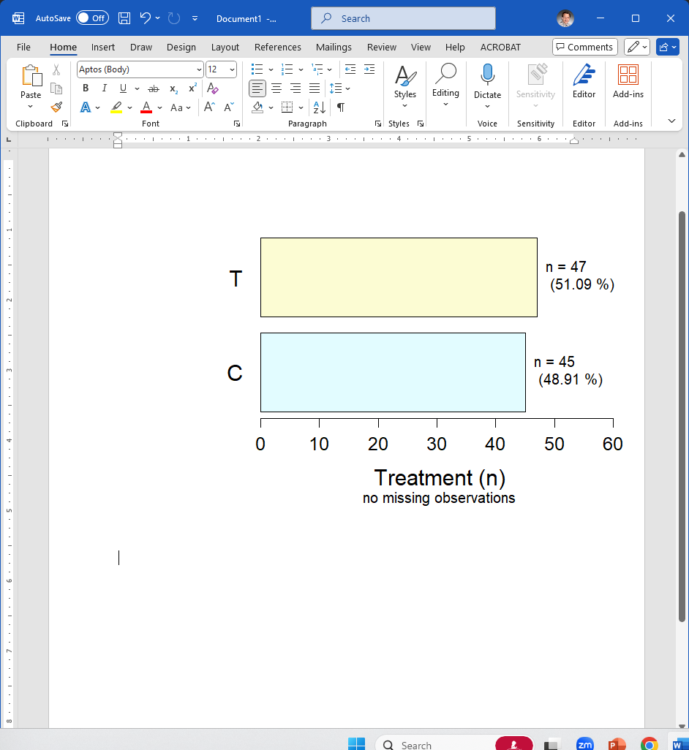
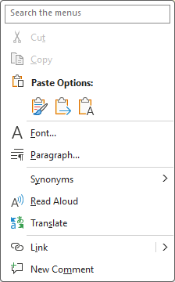
In Word,
Right click
Choose paste (text only)
Table with commas is inserted.

Slide 68
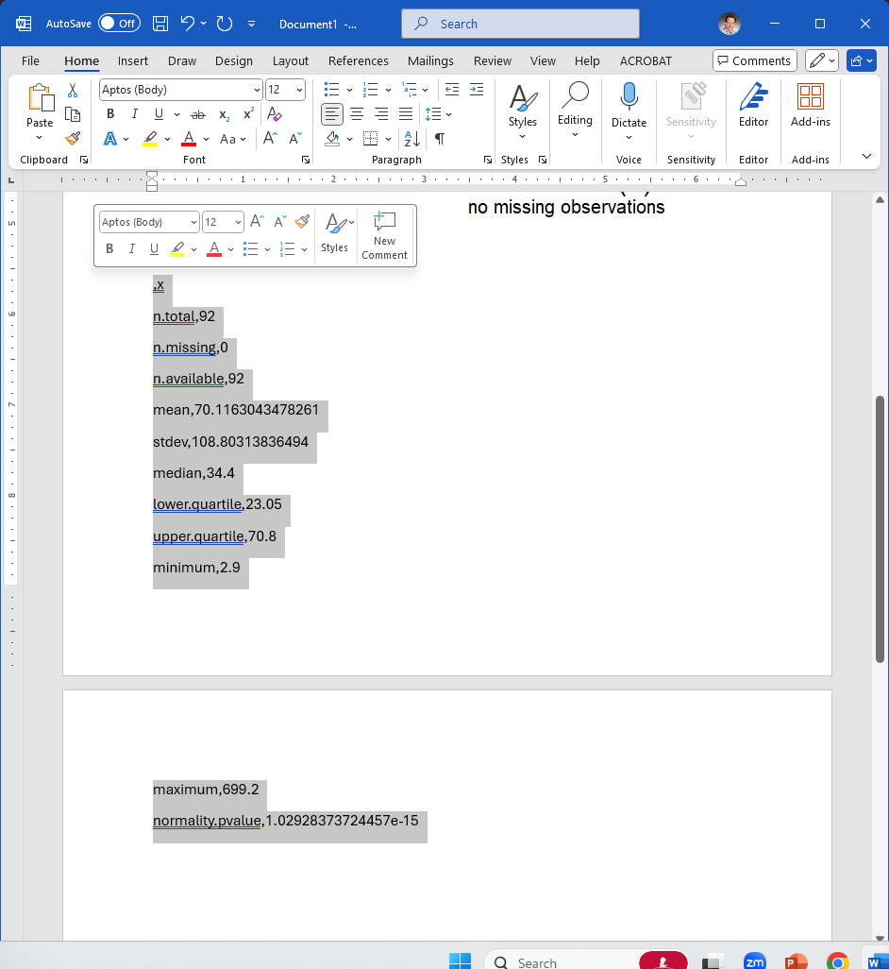
Highlight the table with commas.

Slide 69
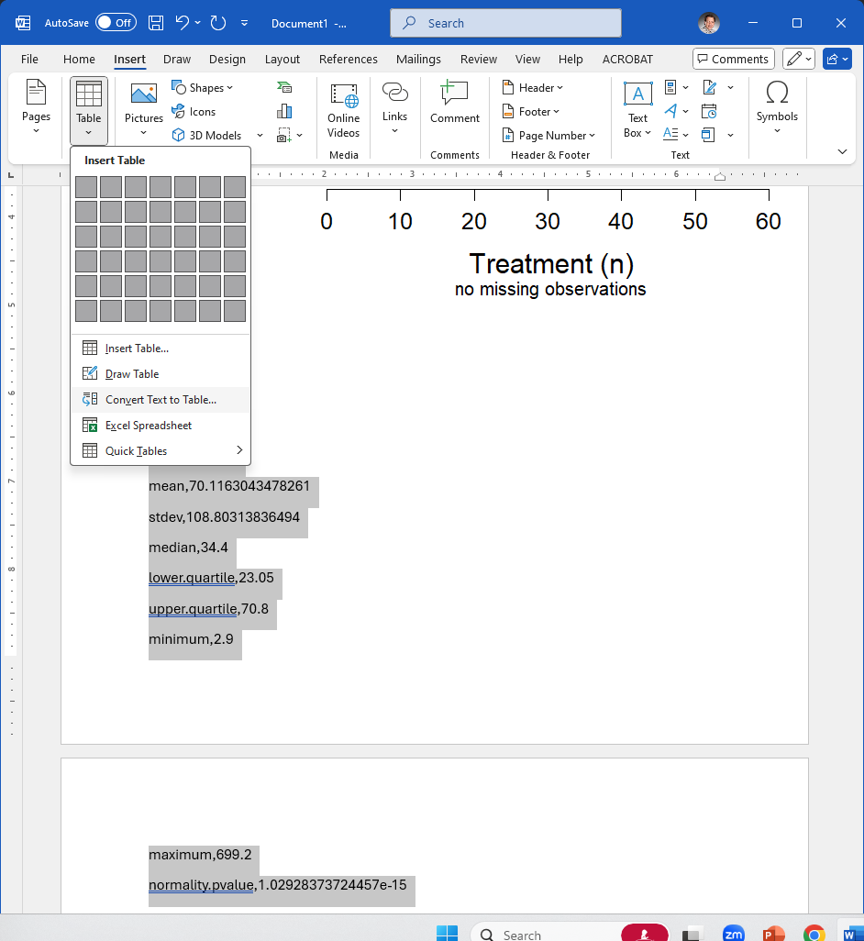
Go to Insert
Then Table
Then Convert Text to Table.
Click OK.

Slide 70

Now you have a (sort of)
nice looking table in your Word file!

Slide 71


Highlight, right click, copy in R.
In Word, right click and paste.
Edit to make it look and read nice.

Slide 72
For Practice
Try making your own descriptive report for another variable in this data set.

